Slide 1



RECAP- Deep Learning

Slide 2
Prompt Engineering
Courtesy:, deeplearning.ai ,

Slide 3
Outline
Fundamentals of Prompting
Shot-Based Prompting-Zero-Shot, One-Shot, Few-Shot
Reasoning-Based Prompting
Chain-of-Thought (CoT) Prompting
One-Shot CoT
Few-Shot CoT
Self-Consistency CoT
Tree of Thoughts (ToT)
Interaction and Feedback-Based Prompting
ReAct Prompting (Reasoning + Acting)
Positive and Negative Prompting
Iterative Prompting
Model-Guided Prompting
Instruction and Role-Based Prompting
Instruction Prompting
Role Prompting
5. Knowledge-Augmented Prompting
Generated Knowledge Prompting (GKP)

Slide 4
Fundamentals of Prompting

Slide 5
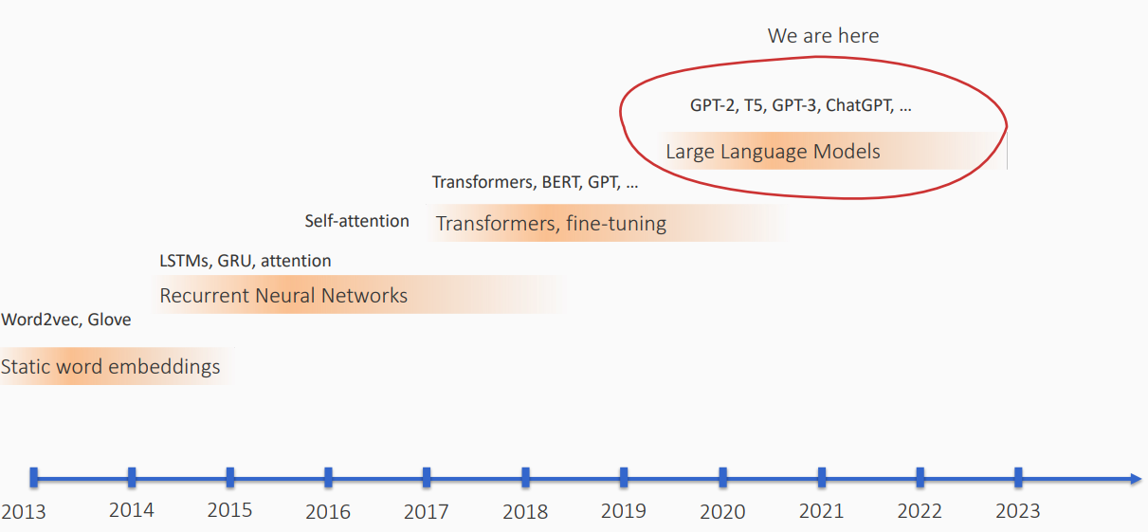
Where are we?

Slide 6
“pre-train, prompt, and predict”.
In Paradigm : “pre-train, prompt, and predict”. In this paradigm, instead of adapting
pre-trained LMs to downstream tasks via objective engineering, downstream tasks are reformulated to look more like those solved during the original LM training with the help of a textual prompt..
In this way, by selecting the appropriate prompts we can manipulate the model behavior so that the pre-trained LM itself can be used to predict the desired output, sometimes even without any additional task-specific training
For example, when recognizing the emotion of a social media post,
“I missed the bus today.”, we may continue with a prompt “I felt so ”, and
ask the LM to fill the blank with an emotion-bearing word. Or
if we choose the prompt “English: I missed the bus today. French: ”), an LM may be able to fill in the blank with a French translation
The advantage of this method is that, given a suite of appropriate prompts, a single LM trained in an
entirely unsupervised fashion can be used to solve a great number of tasks (Brown et al., 2020; Sun et al., 2021).
However, as with most conceptually enticing prospects, there is a catch – this method introduces the necessity for
prompt engineering, finding the most appropriate prompt to allow a LM to solve the task at hand.

Slide 7
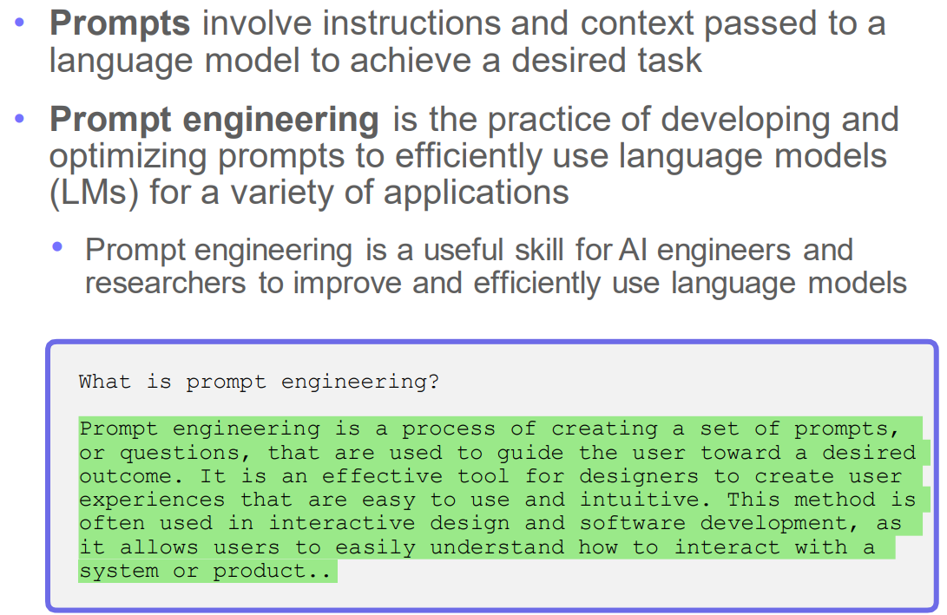
What are prompts?
simple examples of prompts may be:
“Write an email asking for 3 days’ leave from my manager.”
“Create a line drawing of a koala riding a bike on Mars.”

Slide 8
What is prompt Engineering?
Prompt engineering is the practice of guiding large language model (LLM) outputs by providing the model ,context on the type of information to generate.
Depending on the LLM, prompts can take the form of text, images, or even audio. Embedding refers to the process of encoding any kind of information into numerical format by representing key features of the input as a numerical vector. The LLM can then perform mathematical operations on these embeddings to generate a desired output. Once a user inputs a prompt, it is embedded and then sent to the model, acting as an instruction set for how the model should generate its output.
You can achieve a lot with simple prompts, but the quality of results depends on how much information you provide it and how well-crafted the prompt is.
A prompt can contain information like the instruction or question you are passing to the model and
include other details such as context, inputs, or examples.
You can use these elements to instruct the model more effectively to improve the quality of results.

Slide 9
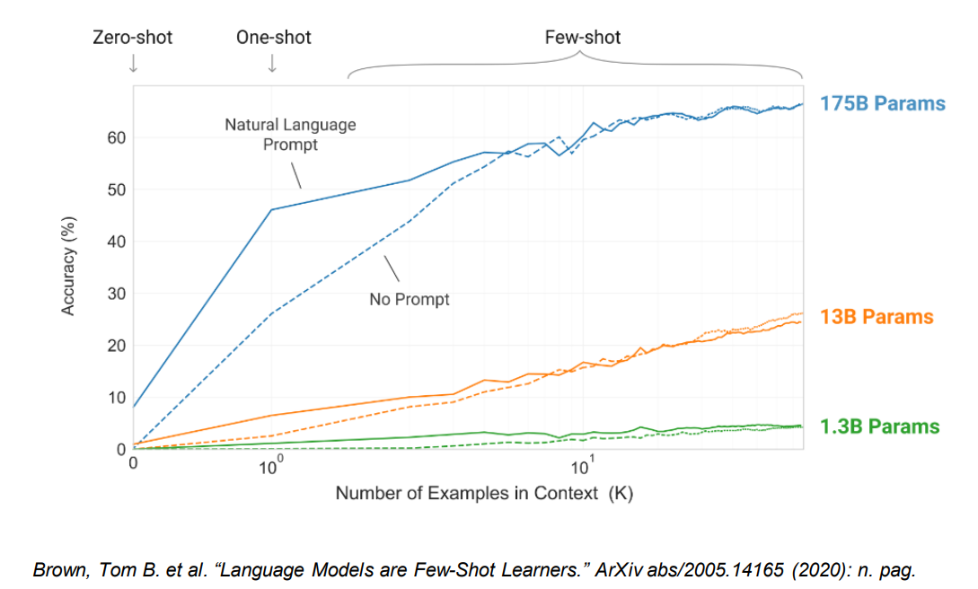
Rise of In-context Learning
models learn from examples directly embedded in the prompt rather than requiring additional training or fine-tuning
Quick adaptation to new tasks or domains with minimal input.
No need for retraining or fine-tuning.
Can be used for a wide range of tasks by providing sufficient examples.

Slide 10
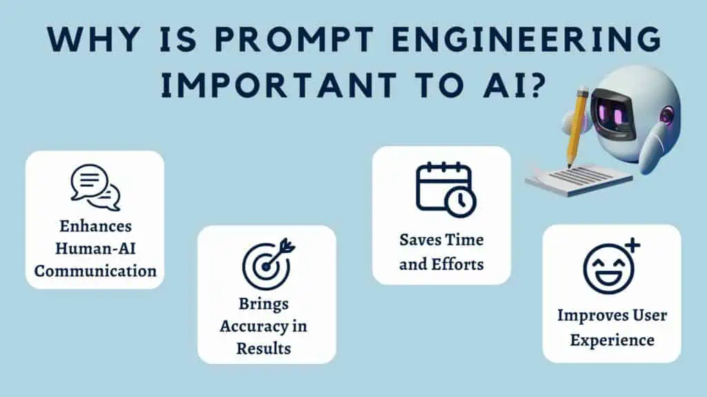
Why?
Notes:
https://kripeshadwani.com/what-is-prompt-engineering/

Slide 11
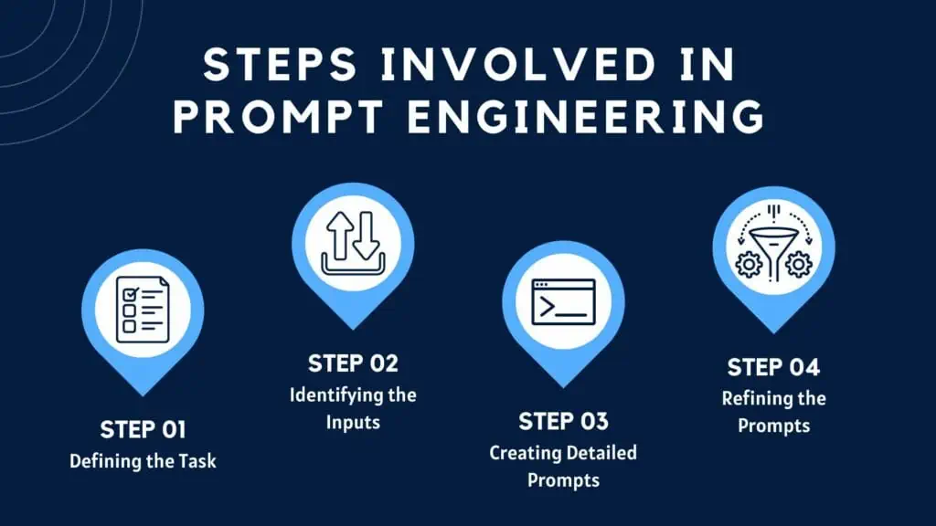
How?

Slide 12
Settings to keep in mind
When prompting a language model, you should keep in mind a few settings
You can get very different results with prompts when using different settings
One important setting is controlling how deterministic the model is when generating completion for prompts
Temperature and top_p are two important parameters to keep in mind
Generally, keep these low if you are looking for exact answers
…keep them high if you are looking for more diverse responses
Temperature
controls sharpness of the next-token distribution
value between 0 to 1
lower temperature -> sharper distribution -> repetitive generations
Top p
value between 0 to 1
select smallest set of tokens whose total likelihood exceeds p. Redistribute the probabilities
smaller p leads to repetitive generations

Slide 13
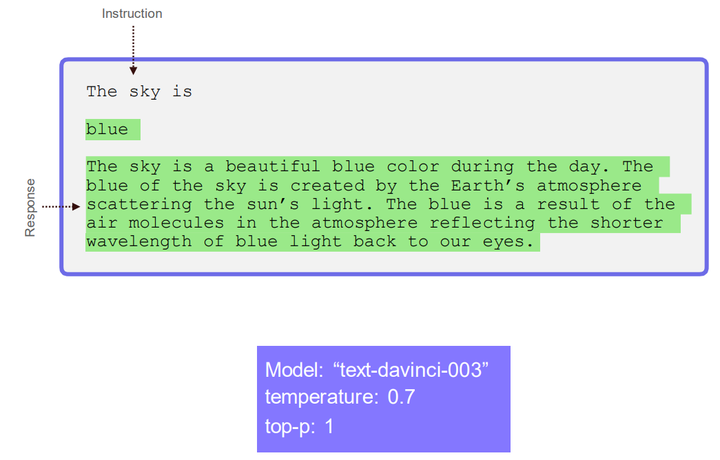
First Basic Prompt

Slide 14
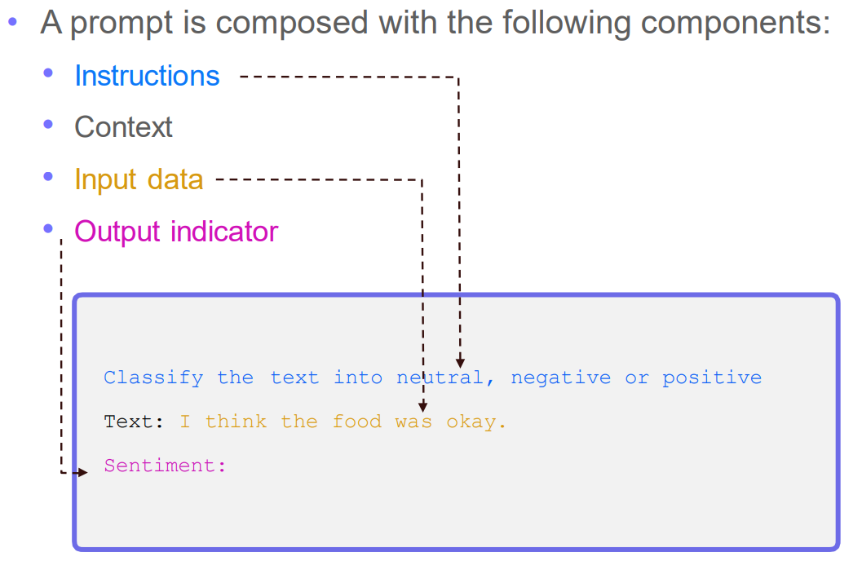
Elements of a Prompt

Slide 15
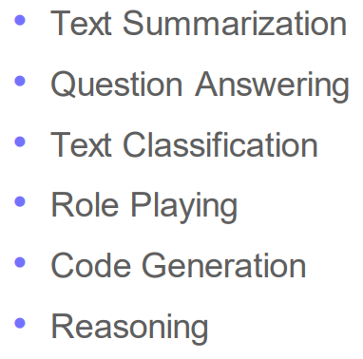
Designing Prompts for Different Tasks

Slide 16
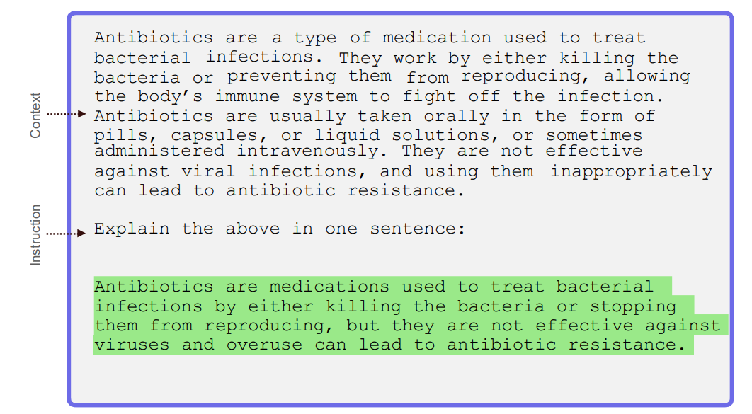
Text Summarization

Slide 17
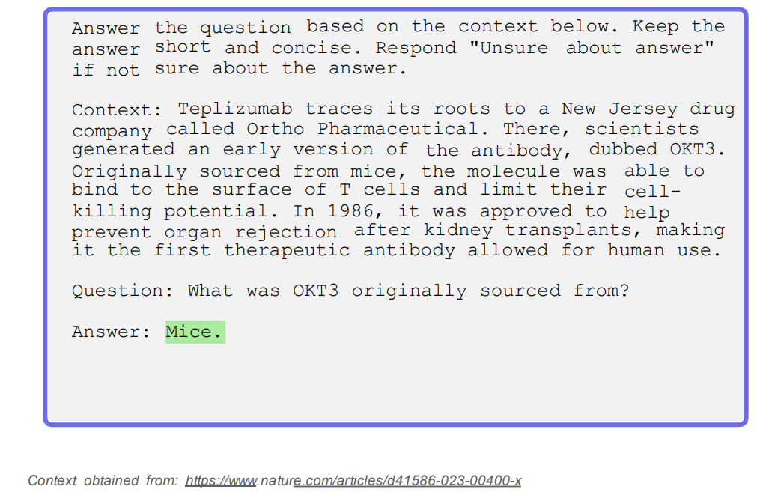
Question Answering

Slide 18
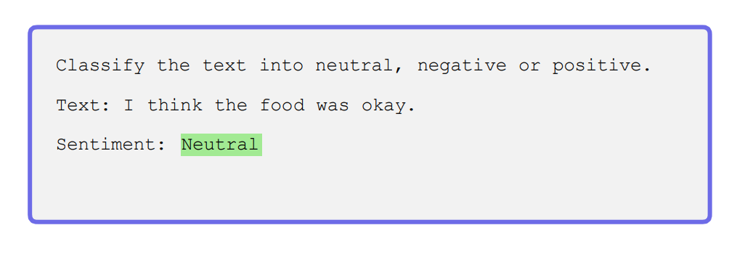
Text Classification

Slide 19
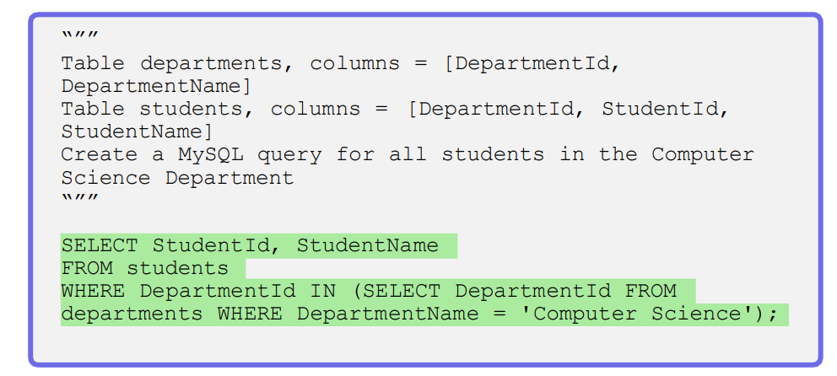
Code Generation

Slide 20
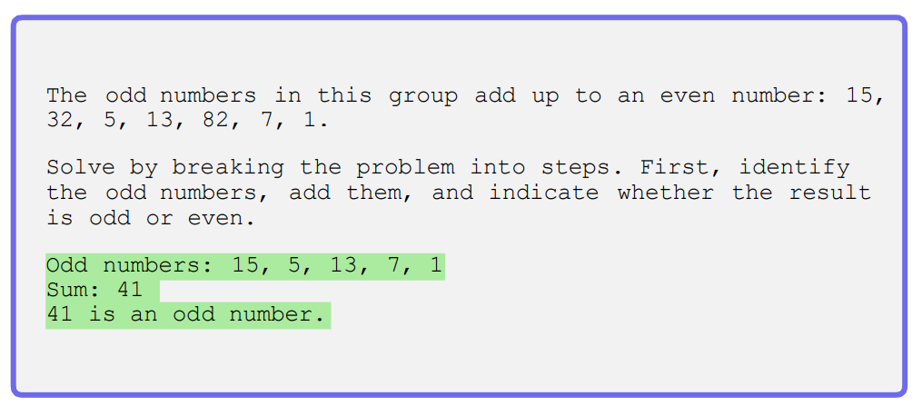
Reasoning

Slide 21
In-Context Learning (ICL)
Allows models to learn from examples within the prompt—no extra training or fine-tuning needed.
Examples guide the AI to understand the task and output style by leveraging pattern recognition.
Useful when instructions alone aren’t enough, or when a specific format/style is required.
Example-driven prompts help the model generalize to new, similar inputs.
Notes:
When giving AI models instructions, we can improve their performance by providing examples. This technique is called In-Context Learning (ICL). It allows models to learn from examples embedded directly in the prompt, rather than needing additional training or fine-tuning. By including examples, we guide the AI to better understand the task and expected output, leveraging its pattern recognition abilities.
In-Context Learning is especially useful for tasks where instructions alone may not be enough, or when a certain structure or style is required in the output. Showing examples within the prompt helps the model apply patterns it has learned to similar, unseen inputs.

Slide 22
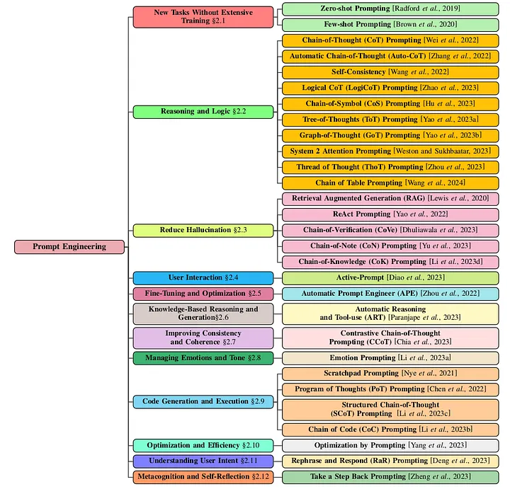
Prompt engineering techniques in LLMs
Notes:
https://medium.com/@manojkumal/summary-of-different-prompt-engineering-techniques-in-llm-based-on-applications-95b43c361422

Slide 23
Types of Prompting
Shot-Based Prompting-Zero-Shot, One-Shot, Few-Shot
Reasoning-Based Prompting
Chain-of-Thought (CoT) Prompting
One-Shot CoT
Few-Shot CoT
Self-Consistency CoT
Tree of Thoughts (ToT)
Instruction and Role-Based Prompting
Instruction Prompting
Role Prompting
Interaction and Feedback-Based Prompting
ReAct Prompting (Reasoning + Acting)
Positive and Negative Prompting
Iterative Prompting
Model-Guided Prompting

Slide 24
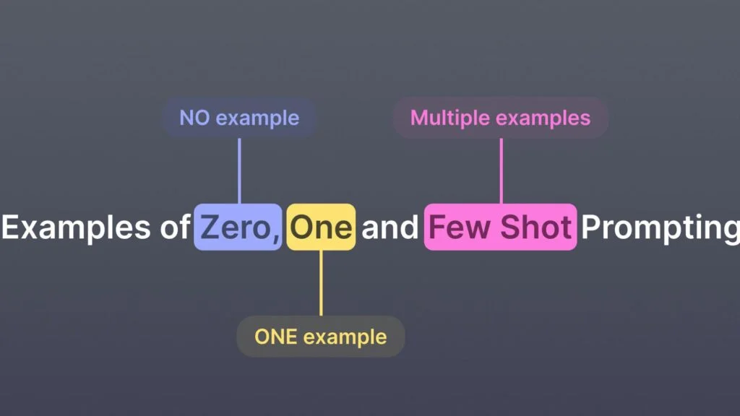
Shot-Based Prompting
"Shots" = number of examples in the prompt.

Slide 25
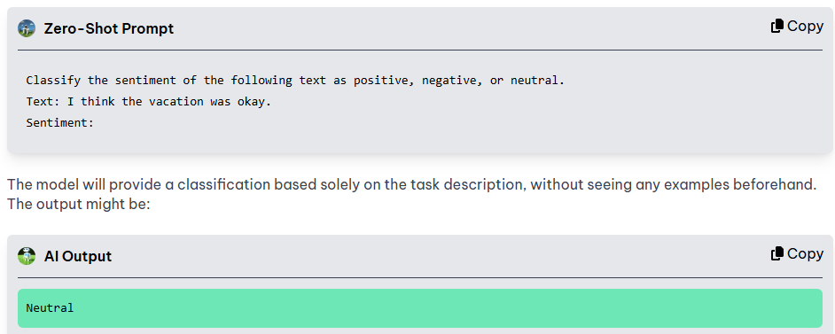
Zero-Shot Prompting
we give the model a direct instruction to perform a task without providing any examples or demonstrations. This means the model has to rely entirely on its pre-trained knowledge to figure out how to complete the task

Slide 26
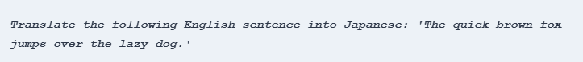
Examples of zero-shot prompting in practice:
Multilingual Translation
Question Answering
Content Summarization

Slide 27
Advantages
Versatility | Enables AI to handle a wide range of tasks without task-specific training.
Resource Efficiency | Reduces the need for large labeled datasets, saving time and energy.
Rapid Deployment | Allows faster development and execution for new tasks.
Generalization | Performs well even with limited information or examples.
Reduced Cost | Minimizes the cost of model development due to lower data and resource needs.
Customization | Prompts can be tailored to specific tasks for better task alignment.
Limitations
Scalability Issues | Scaling to many tasks may require more resources and significant tuning.
Complex Domain Knowledge | May struggle with tasks requiring deep, field-specific expertise.
Limited Control | Users have less influence over the model’s internal decision-making process.

Slide 28
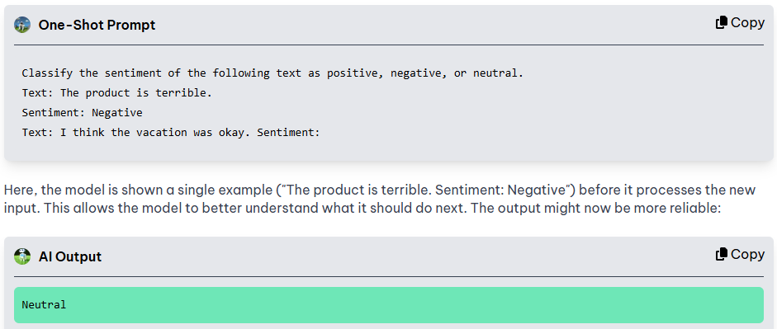
One-shot Prompting
enhances zero-shot prompting by providing a single example before the new task, which helps clarify expectations and improves model performance

Slide 29
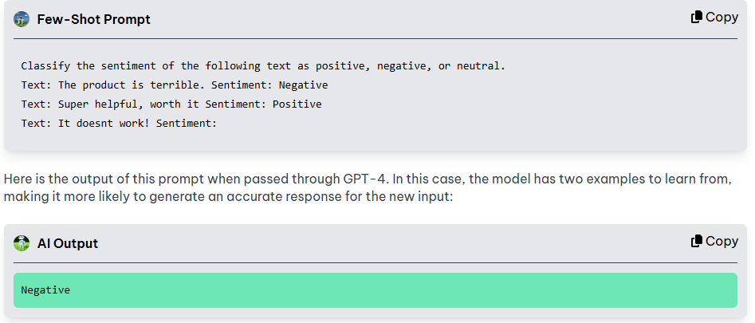
Few-Shot Prompting
provides two or more examples, which helps the model recognize patterns and handle more complex tasks. With more examples, the model gains a better understanding of the task, leading to improved accuracy and consistency.
Notes:
https://learnprompting.org/docs/basics/few_shot

Slide 30
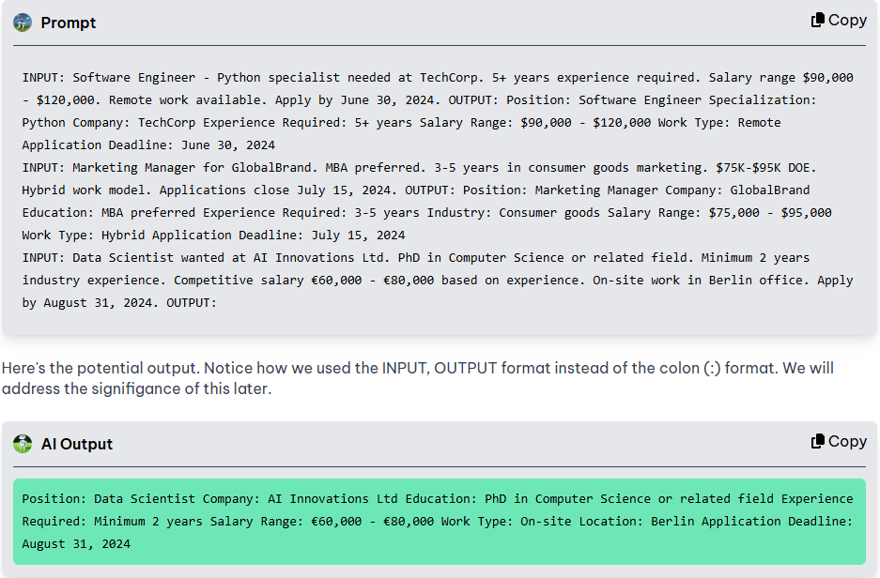
Few shot

Slide 31
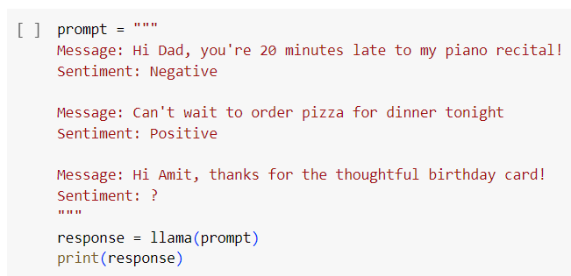

Slide 32
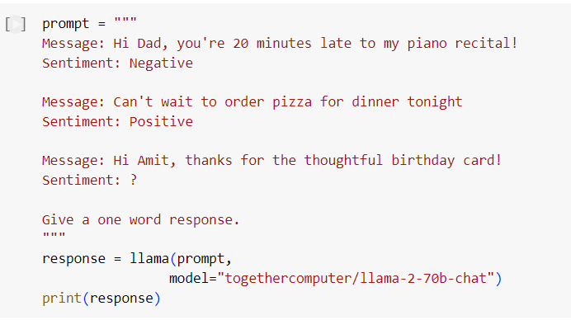

Slide 33
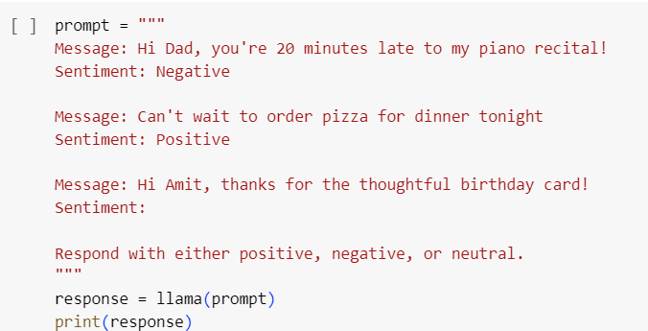

Slide 34
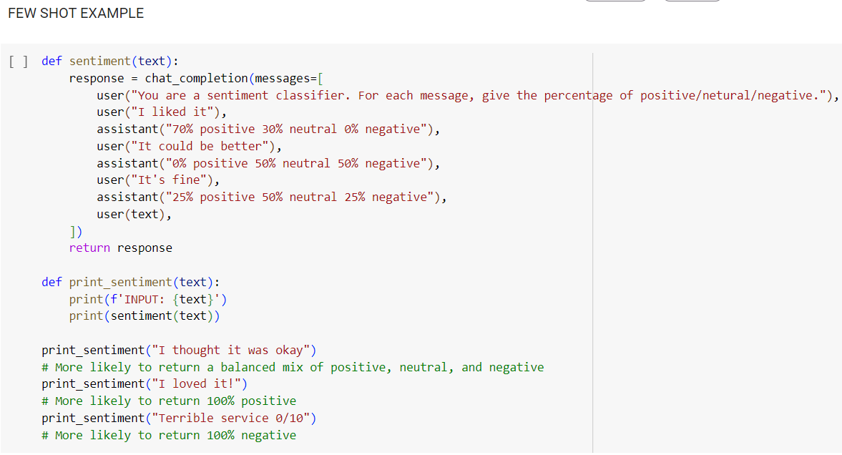

Slide 35
Aspect | Zero-Shot Prompting | One-Shot Prompting | Few-Shot Prompting
Definition | No example is provided in the prompt. | One example is included in the prompt. | Two or more examples are provided in the prompt.
Training Need | No task-specific training or examples needed. | Minimal task guidance via one example. | More detailed task guidance via multiple examples.
Ease of Use | Easiest to implement. | Slightly more effort to include a relevant example. | Requires careful selection of multiple representative examples.
Model Understanding | Relies solely on pre-trained knowledge. | Gains some task-specific clarity from the example. | Recognizes patterns and structure more clearly.
Performance | May be less accurate, especially for complex tasks. | Moderately improved performance. | Generally better performance with nuanced tasks.
Best Use Case | Simple or common tasks with clear instructions. | Tasks with a unique output style or structure. | Complex tasks or those with ambiguous requirements.
Example Complexity | No examples: "Translate to French: Good morning" | One example: "English: Hello → French: Bonjour\nTranslate: Hi" | Multiple examples of inputs and outputs in the prompt.

Slide 36
How to Choose the Right Prompting Technique
Zero-shot prompting: Use this when the task is simple, well-understood, or frequently encountered in the model's training data. It's efficient for tasks like basic arithmetic, general queries, or sentiment classification for common phrases.
One-shot prompting: This is helpful for tasks that need more specific guidance or when the model struggles with ambiguity. Providing a single example can clarify the task, improving accuracy in tasks like basic classification or structured information extraction.
Few-shot prompting: Best used for complex tasks requiring multiple examples to establish patterns. This technique is ideal for tasks that involve varied inputs, require precise formatting, or demand a higher degree of accuracy, such as generating structured outputs or handling nuanced classifications.

Slide 37
Types of Prompting
Shot-Based Prompting-Zero-Shot, One-Shot, Few-Shot
Reasoning-Based Prompting
Chain-of-Thought (CoT) Prompting
One-Shot CoT
Few-Shot CoT
Self-Consistency CoT
Tree of Thoughts (ToT)
Interaction and Feedback-Based Prompting
ReAct Prompting (Reasoning + Acting)
Positive and Negative Prompting
Iterative Prompting
Model-Guided Prompting
Instruction and Role-Based Prompting
Instruction Prompting
Role Prompting

Slide 38
Reasoning-Based Prompting
designing prompts that help the model simulate logical reasoning or problem-solving processes rather than just providing a direct answer
Mimics human-like thinking patterns
Chain-of-Thought (CoT) Prompting
One-Shot CoT
Few-Shot CoT
Self-Consistency CoT
Tree of Thoughts (ToT)

Slide 39
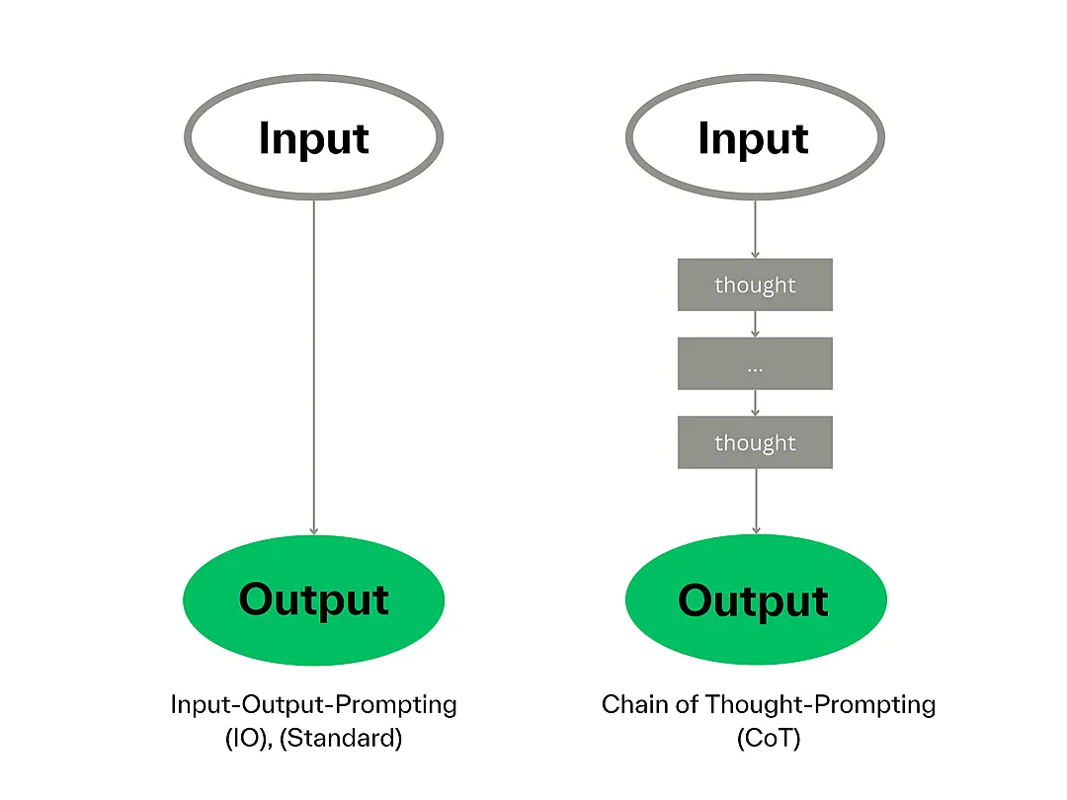
Chain-of-Thought (CoT) Prompting
complex reasoning capabilities through intermediate reasoning steps.
Helps the model think systematically and build a solution strategy step by step.
Involves a series of linked questions or steps that guide reasoning toward the answer.
Encourages the AI to break down complex tasks into smaller, logical parts.
Notes:
https://www.promptingguide.ai/techniques/cot
https://www.tha.de/en/Types-of-prompting.html

Slide 40
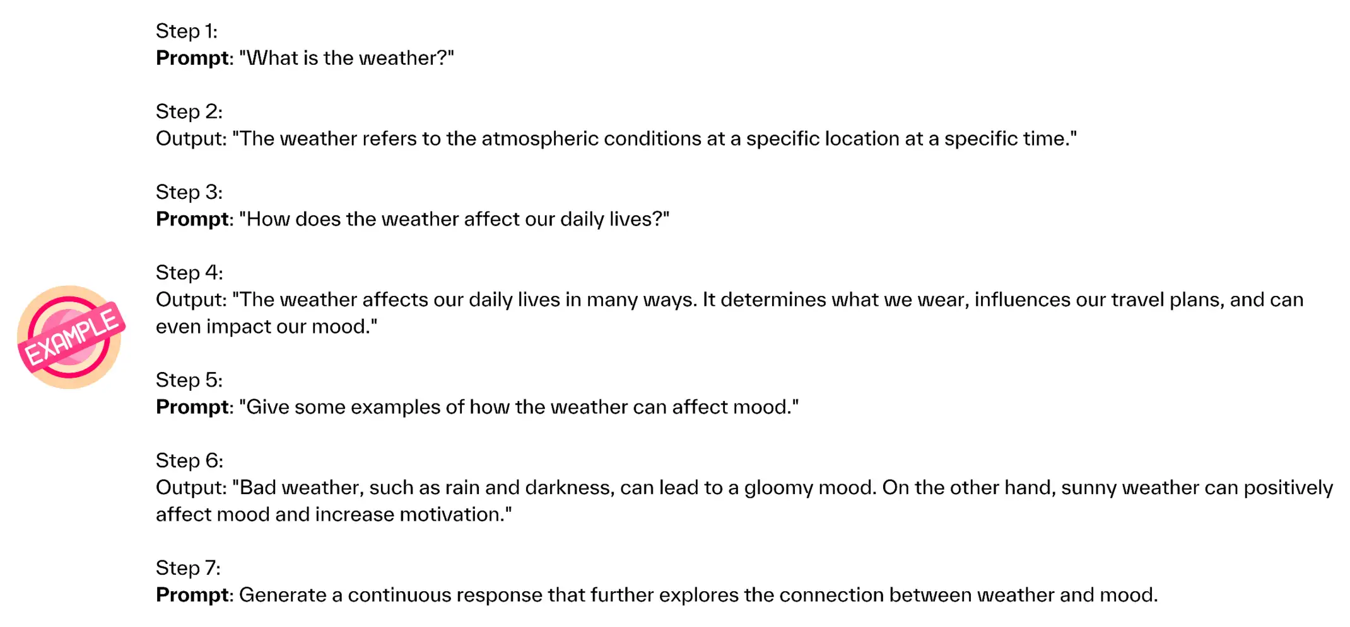

Slide 41
Chain-of-thought
Chain-of-thought prompting is a technique designed to guide the AI model through a logical reasoning process. Rather than just asking for an output, this strategy incorporates a "chain of thought" that demonstrates how to arrive at the correct answer step by step. This approach is especially valuable for tasks requiring critical thinking or problem-solving skills, like mathematical calculations or complex queries. Example. Suppose you're in charge of optimizing fuel efficiency for a transportation company's fleet of trucks. You can employ chain-of-thought prompting to guide the model through this complex task as follows.
Prompt: "You're the fleet manager for a transportation company with 50 diesel trucks. Each truck gets 6 miles per gallon, and the fleet covers a total of 10,000 miles each day. You're looking to reduce fuel consumption to save costs. Let’s think step by step."

Slide 42
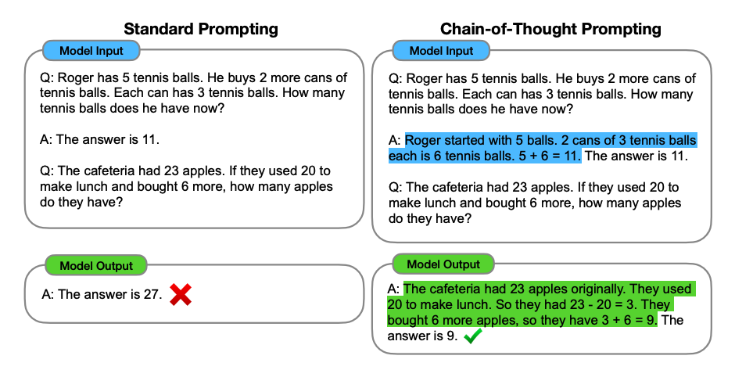

Slide 43
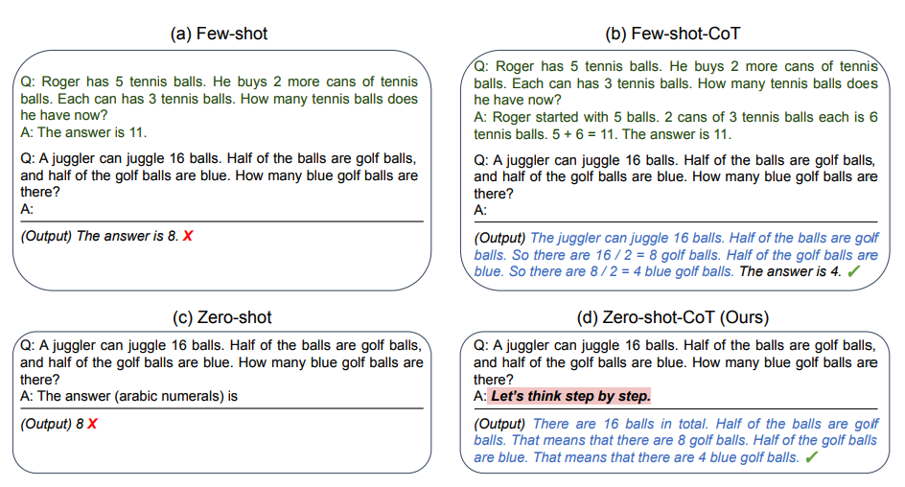

Slide 44
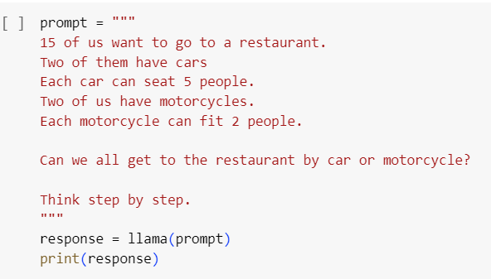
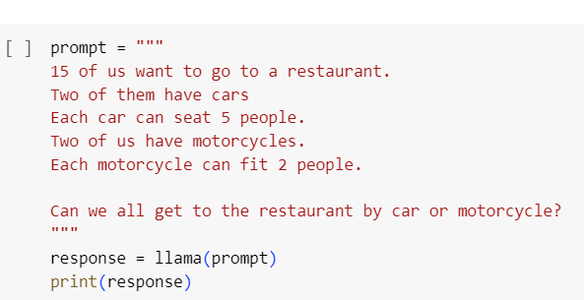
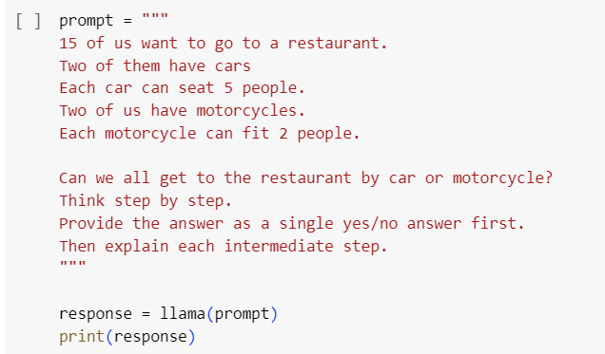
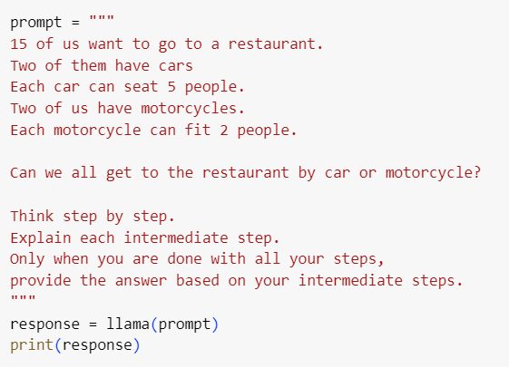
Chain of thought

Slide 45
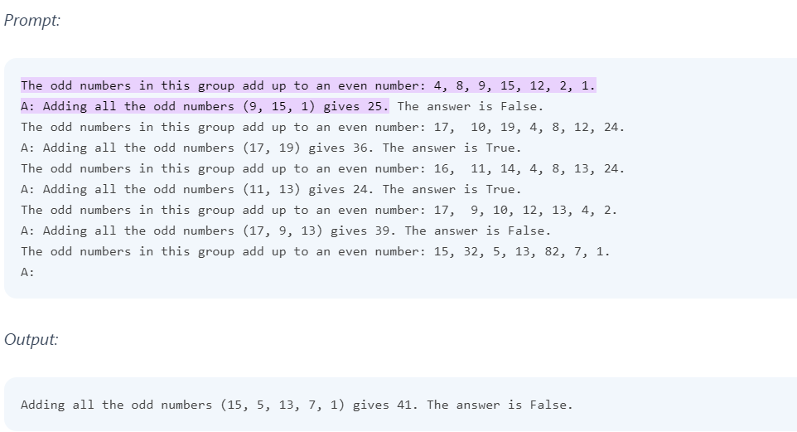

Slide 46
One-Shot & Few-Shot Chain-of-Thought (CoT) Prompting
One-Shot CoT: Provides a single example with detailed reasoning steps.
Few-Shot CoT: Includes multiple examples of reasoning-based answers.
One-Shot CoT Example
Prompt:
Q: If you have 3 apples and you buy 2 more, how many apples do you have? A: Let's think step by step. I start with 3 apples. Then I buy 2 more apples. So, 3 + 2 = 5 apples. Therefore, the answer is 5.
New Question:
Q: If you have 4 pencils and find 3 more, how many pencils do you have? A: Let's think step by step. I start with 4 pencils. Then I find 3 more pencils. So, 4 + 3 = 7 pencils.
Few-Shot CoT Example
Prompt:
Q1: If a book costs $5 and you buy 2 books, how much do you spend? A: Let's think step by step. One book costs $5. Buying 2 books means 5 × 2 = $10. So, the answer is $10.
Q2: If there are 6 students and each student has 3 notebooks, how many notebooks are there in total? A: Let's think step by step. Each of the 6 students has 3 notebooks. So, 6 × 3 = 18 notebooks. So, the answer is 18.
New Question:
Q3: If there are 4 bags and each bag contains 5 apples, how many apples are there in total? A: Let's think step by step. Each of the 4 bags has 5 apples. So, 4 × 5 = 20 apples.

Slide 47
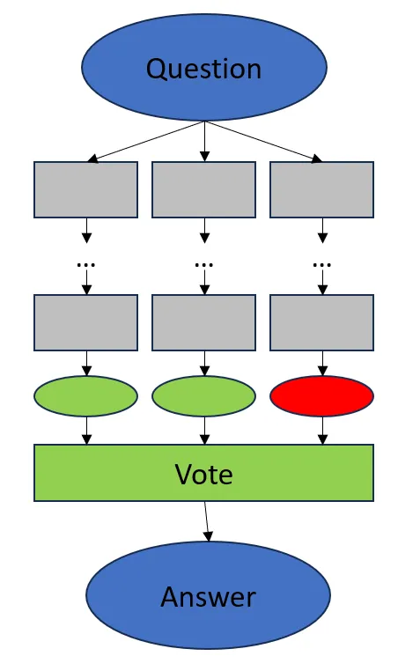
Chain-of-Thought (CoT) with Self-Consistency
Introduced by Wang et al. in “Self-Consistency Improves Chain of Thought Reasoning in Language Models” (2022).
Enhances standard CoT by improving the accuracy and reliability of generated responses.
Assumes the correct answer exists in the model and appears in majority of multiple responses.
The same question is asked multiple times, generating diverse reasoning paths.
A majority vote is taken across responses to select the most consistent, likely correct answer.
This process synthesizes one final, reliable answer from multiple attempts.
Results in higher-quality reasoning and improved performance on complex tasks.

Slide 48
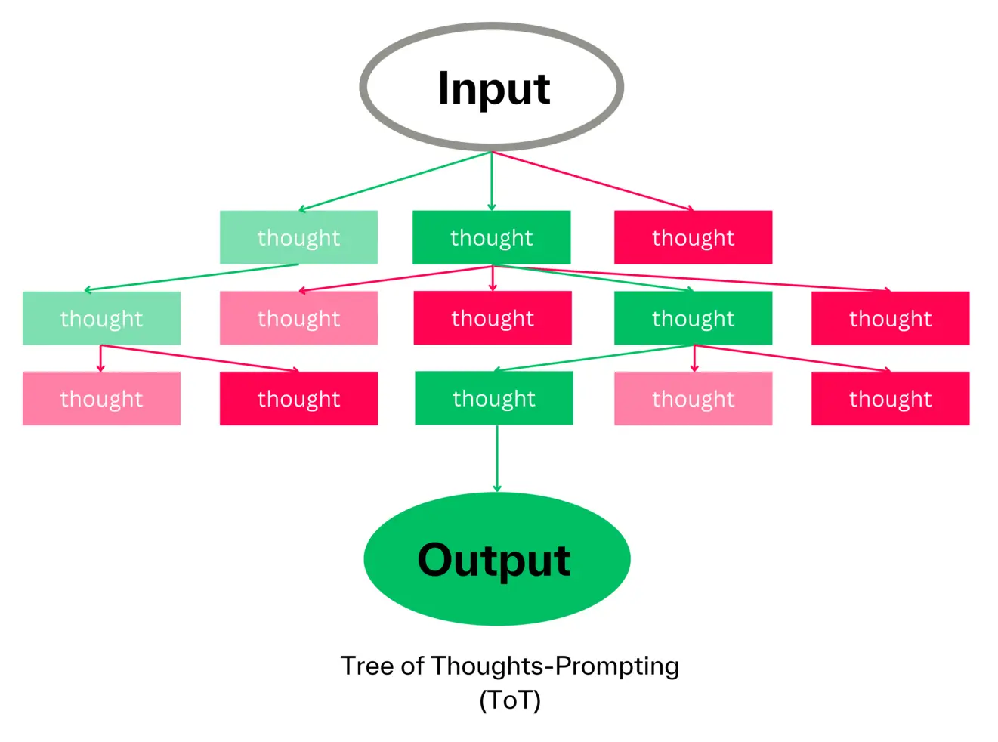
Tree of Thoughts-Prompting

Slide 49
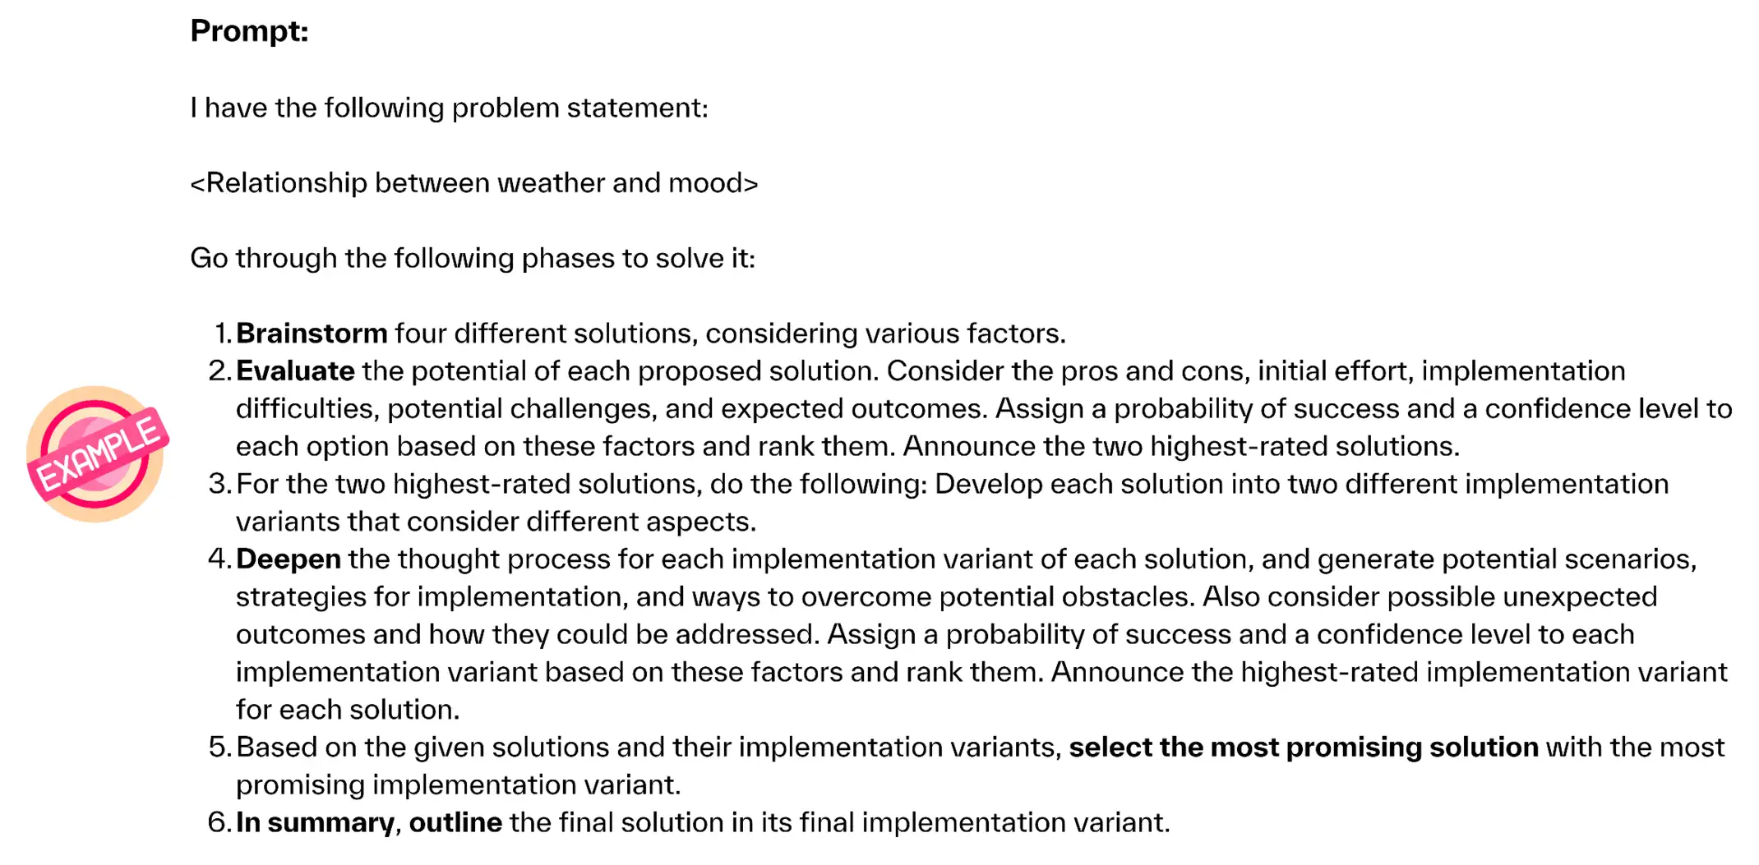

Slide 50
Types of Prompting
Shot-Based Prompting-Zero-Shot, One-Shot, Few-Shot
Reasoning-Based Prompting
Chain-of-Thought (CoT) Prompting
One-Shot CoT
Few-Shot CoT
Self-Consistency CoT
Tree of Thoughts (ToT)
Interaction and Feedback-Based Prompting
ReAct Prompting (Reasoning + Acting)
Positive and Negative Prompting
Iterative Prompting
Model-Guided Prompting
Instruction and Role-Based Prompting
Instruction Prompting
Role Prompting
5. Knowledge-Augmented Prompting
Generated Knowledge Prompting (GKP)

Slide 51
Interaction and Feedback-Based Prompting
A prompting approach where the LLM interacts with intermediate outputs, external environments, or iterative prompts to refine its reasoning and actions.
Dynamic and adaptable.
ReAct Prompting (Reasoning + Acting)
Positive and Negative Prompting
Iterative Prompting
Model-Guided Prompting

Slide 52
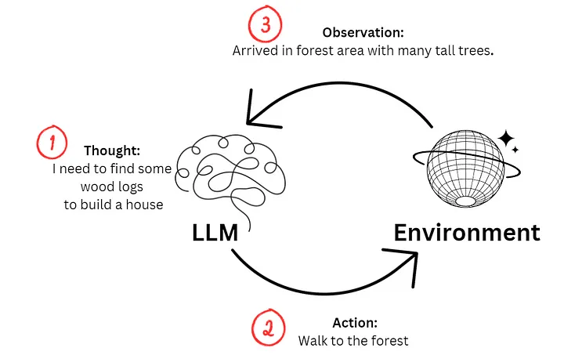
ReAct
ReAct = "Reasoning and Acting" – separates reasoning from action-taking in AI models.
Feeds observations to the LLM, allowing it to update context dynamically.
Model re-evaluates and responds step-by-step based on updated insights.
Different from Chain-of-Thought (CoT) – reasoning isn't static or embedded in one prompt.
Enables structured handling of complex queries, improving output quality.
Helps LLMs produce more informed, accurate, and coherent responses.

Slide 53
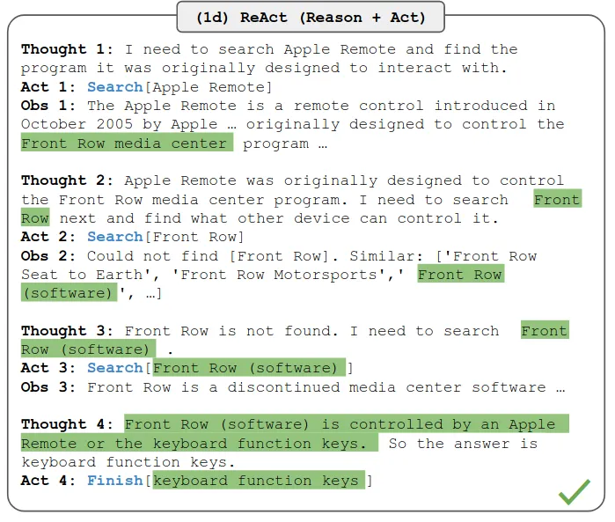
ReAct

Slide 54
Positive and negative prompting
Positive and negative prompting are techniques used to guide the model's output in specific directions. As the names suggest, positive prompting encourages the model to include certain types of content or responses, while negative prompting discourages it from including other specific types. This framing can be vital in controlling the direction and quality of the model’s output.
Here’s what your positive prompt could look like: "You are a sustainability expert. Generate a list of five feasible strategies for a small business to reduce its carbon footprint." Building on the above scenario, you should ensure the model doesn't suggest too expensive or complicated strategies for a small business. So you extend your initial prompt as follows: "You are a sustainability expert. Generate a list of five feasible strategies for a small business to reduce its carbon footprint. Do not include suggestions that require an initial investment of more than $10,000 or specialized technical expertise." Adding the negative prompting here filters out too expensive or technical strategies, tailoring the model's output to your specific requirements.

Slide 55
Iterative prompting
Iterative prompting is a strategy that involves building on the model's previous outputs to refine, expand, or dig deeper into the initial answer. This approach enables you to break down complex questions or topics into smaller, more manageable parts, which can lead to more accurate and comprehensive results. The key to this technique is paying close attention to the model's initial output. You can then create follow-up prompts to explore specific elements, inquire about subtopics, or ask for clarification. This approach is useful for projects that require in-depth research, planning, or layered responses.

Slide 56
Iterative prompting
Example. Your initial prompt might be:
"I am working on a project about fraud prevention in the travel industry. Please provide me with a general outline covering key aspects that should be addressed.”
Assume the model's output includes points like identity verification, secure payment gateways, and transaction monitoring.
Follow-up prompt 1: "Great, could you go into more detail about identity verification methods suitable for the travel industry?"
At this point, the model might elaborate on multifactor authentication, biometric scanning, and secure documentation checks.
Follow-up prompt 2: "Now, could you explain how transaction monitoring can be effectively implemented in the travel industry?"
The model could then discuss real-time monitoring, anomaly detection algorithms, and the role of machine learning in identifying suspicious activities.
This iterative approach allows you to go from a broad question to specific, actionable insights in a structured manner, making it particularly useful for complex topics like fraud prevention in the travel industry.

Slide 57
Model guided prompting
Another useful approach is model-guided prompting, which flips the script by instructing the model to ask you for the details it needs to complete a given task. This approach minimizes guesswork and discourages the model from making things up.
Example. Suppose you work in travel tech and you want an AI model to generate a FAQ section for a new travel booking feature on your platform. Instead of just asking the model to "create a FAQ for a new booking feature," which could result in generic or off-target questions and answers, you could prompt the AI as follows:
"I need you to generate a FAQ section for a new travel booking feature we're launching. Can you ask me for the information you need to complete this?"
ChatGPT might then ask you, "What is the name of the new travel booking feature?" and "What is the primary purpose or functionality of this new feature?" among other things.

Slide 58
Types of Prompting
Shot-Based Prompting-Zero-Shot, One-Shot, Few-Shot
Reasoning-Based Prompting
Chain-of-Thought (CoT) Prompting
One-Shot CoT
Few-Shot CoT
Self-Consistency CoT
Tree of Thoughts (ToT)
Interaction and Feedback-Based Prompting
ReAct Prompting (Reasoning + Acting)
Positive and Negative Prompting
Iterative Prompting
Model-Guided Prompting
Instruction and Role-Based Prompting
Instruction Prompting
Role Prompting
5. Knowledge-Augmented Prompting
Generated Knowledge Prompting (GKP)

Slide 59
Instruction Prompting
providing clear, explicit instructions to the model about how to perform a task.
​
Helps direct the model's focus towards a specific goal.
Examples of Instruction Prompting:
Summarization
Instruction: "Summarize the following article in 3 sentences." Model Output: [Concise summary of the article.]
Sentiment Analysis
Instruction: "Classify the sentiment of the following text as Positive, Negative, or Neutral." Model Output: Positive.
Text Generation
Instruction: "Write a 200-word essay on the impact of climate change on agriculture." Model Output: [Generated essay.]

Slide 60
Role Prompting
The role-playing technique employs a unique approach to crafting prompts: instead of using examples or templates to guide the model's output, you assign a specific "role" or "persona" to the AI model. This often includes explicitly explaining the intended audience, the AI's role, and the goals of the interaction. The roles and goals offer contextual information that helps the model understand the purpose of the prompt and the tone or level of detail it should aim for in its response. Example. Consider the prompt: "You are a prompt engineer, and you need to explain to a 6-year-old kid what your job is."
Prompt: "Your role is a machine learning expert who gives highly technical advice to senior engineers who work with complicated datasets. Explain the pros and cons of using PyTorch."
Expectation: The model provides a more detailed and technical explanation suitable for senior engineers.
Role Prompting: Instructs the model to adopt a specific role or perspective, guiding the output to be more contextually appropriate and detailed.

Slide 61
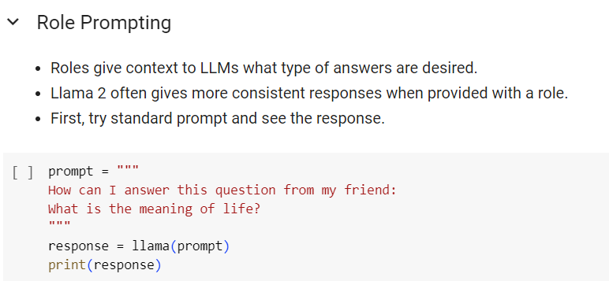

Slide 62
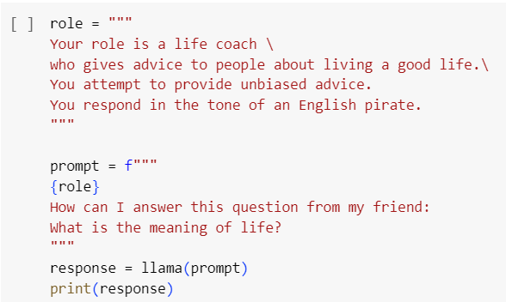

Slide 63
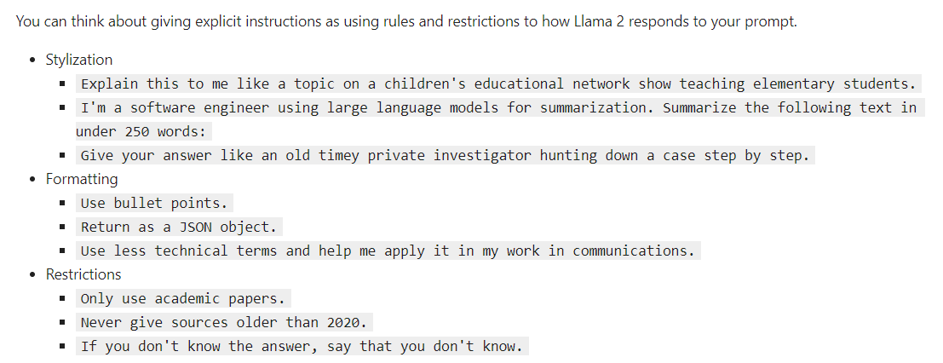

Slide 64
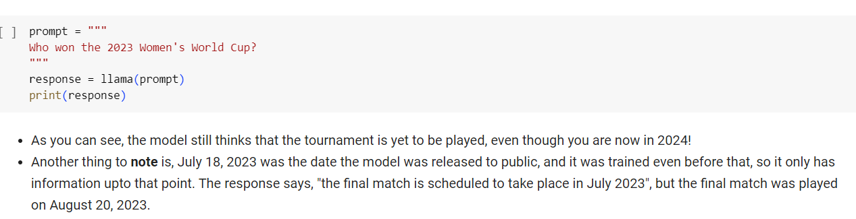

Slide 65
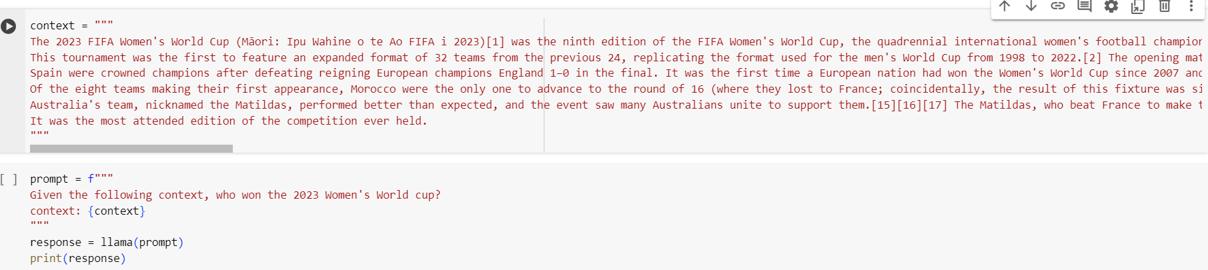

Slide 66
Types of Prompting
Shot-Based Prompting-Zero-Shot, One-Shot, Few-Shot
Reasoning-Based Prompting
Chain-of-Thought (CoT) Prompting
One-Shot CoT
Few-Shot CoT
Self-Consistency CoT
Tree of Thoughts (ToT)
Interaction and Feedback-Based Prompting
ReAct Prompting (Reasoning + Acting)
Positive and Negative Prompting
Iterative Prompting
Model-Guided Prompting
Instruction and Role-Based Prompting
Instruction Prompting
Role Prompting
5. Knowledge-Augmented Prompting
Generated Knowledge Prompting (GKP)

Slide 67
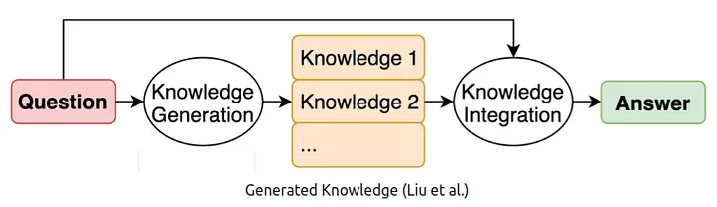
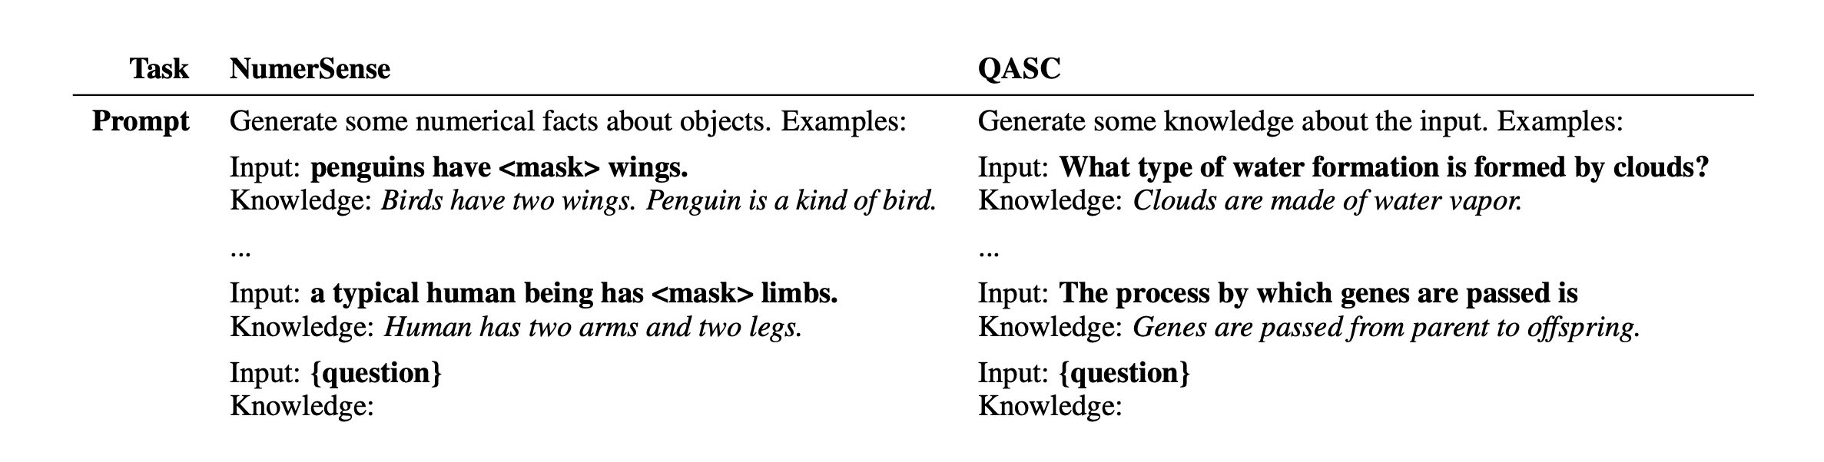
Generated Knowledge Prompting
model first generates relevant background or contextual knowledge and then uses that generated knowledge to inform the task-specific prompt.

Slide 68
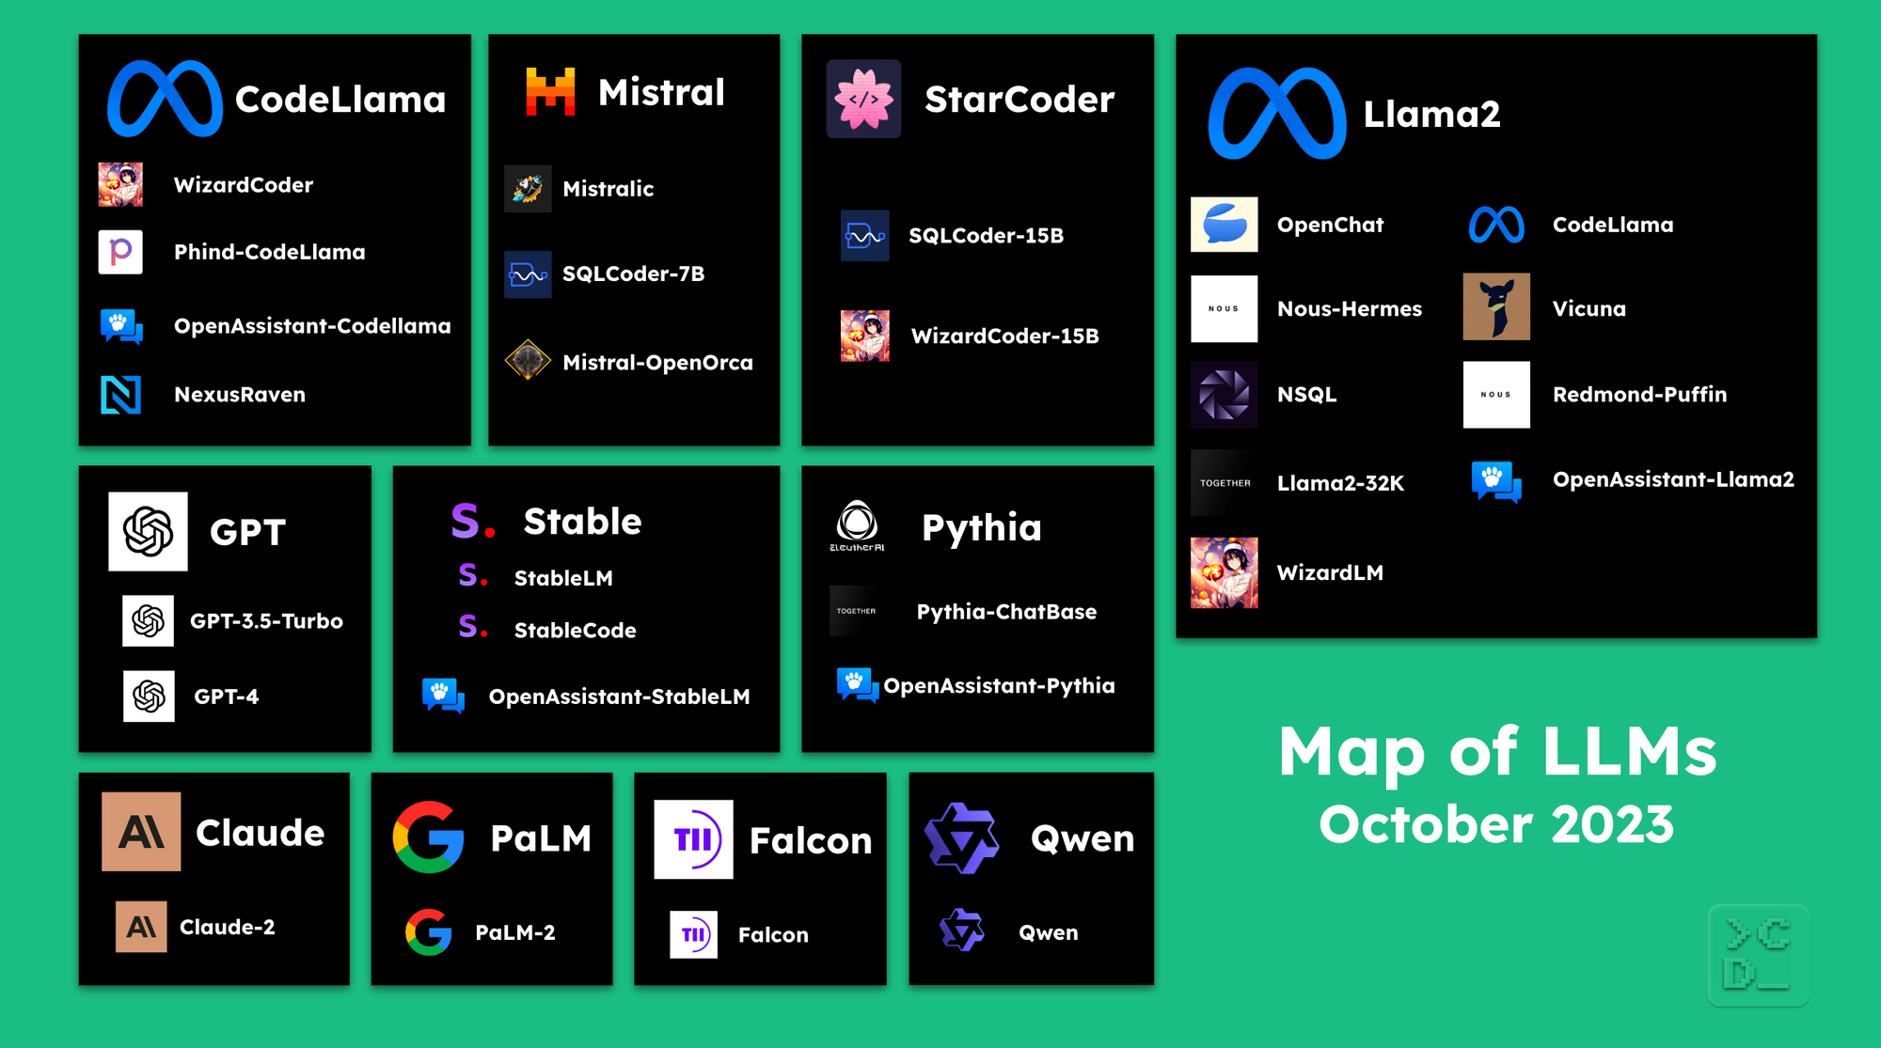

Slide 69
Getting an LLM
Large language models are deployed and accessed in a variety of ways, including:
Self-hosting: Using local hardware to run inference. Ex. running Llama 2 on your Macbook Pro using llama.cpp.
Best for privacy/security or if you already have a GPU.
Cloud hosting: Using a cloud provider to deploy an instance that hosts a specific model. Ex. running Llama 2 on cloud providers like AWS, Azure, GCP, and others.
Best for customizing models and their runtime (ex. fine-tuning a model for your use case).
Hosted API: Call LLMs directly via an API. There are many companies that provide Llama 2 inference APIs including AWS Bedrock, Replicate, Anyscale, Together and others.
Easiest option overall.

Slide 70
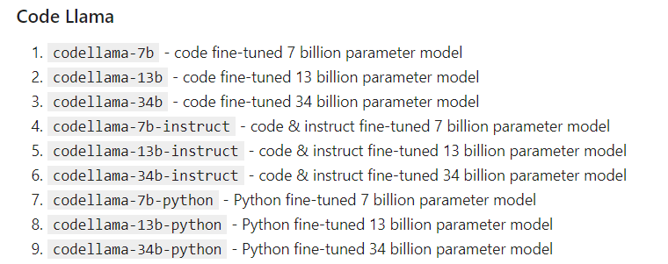
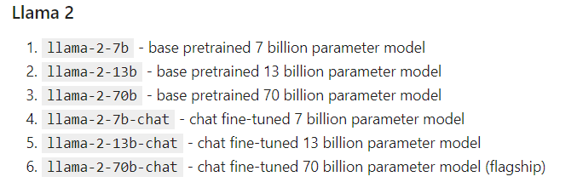
Llama Models
In 2023, Meta introduced the Llama language models (Llama Chat, Code Llama, Llama Guard). These are general purpose, state-of-the-art LLMs.
Llama 2 models come in 7 billion, 13 billion, and 70 billion parameter sizes. Smaller models are cheaper to deploy and run arger models are more capable.
Code Llama is a code-focused LLM built on top of Llama 2 also available in various sizes and finetunes:

Slide 71
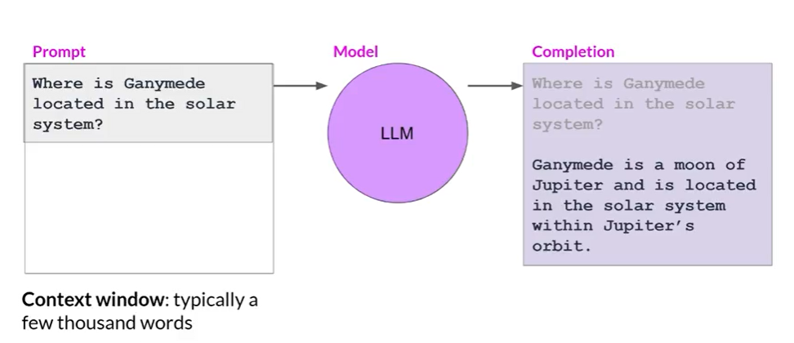
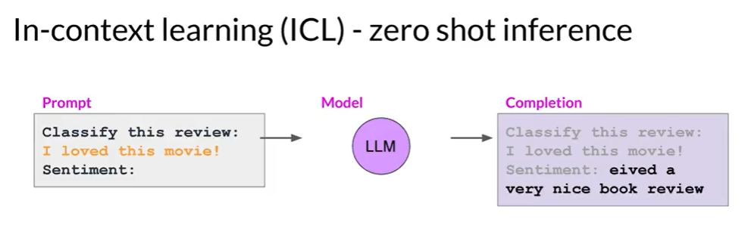
Prompt and prompt engineering (In-context Learning
)
Notes:
https://www.youtube.com/watch?v=V4NbORT6xF4

Slide 72

Fine tuning – why?

Slide 73


Slide 74


Slide 75


Slide 76


Slide 77


Slide 78


Slide 79
Zero- shot prompting
Zero-shot prompting
Zero-shot prompting is one of the most straightforward yet versatile techniques in prompt engineering. At its core, it involves providing the language model with a single instruction, often presented as a question or statement, without giving any additional examples or context. The model then generates a response based on its training data, essentially "completing" your prompt in a manner that aligns with its understanding of language and context. Zero-shot prompting is exceptionally useful for generating fast, on-the-fly responses to a broad range of queries.
Consider you are looking for a sentiment analysis of a hotel review. You could use the following prompt.
“Extract the sentiment from the following review: ‘The room was spacious, but the service was terrible.’”
Without prior training on sentiment analysis tasks, the model can still process this prompt and provide you with an answer, such as "The review has a mixed sentiment: positive towards room space but negative towards the service."

Slide 80


Slide 81


Slide 82
One –shot prompting
One-shot prompting is a technique where a single example guides the AI model's output. This example can be a question-answer pair, a simple instruction, or a specific template. The aim is to align the model's response more closely with the user's specific intentions or desired format.
Let's consider a language model that has never been trained to generate recipes.
With one-shot prompting, you provide the model with a single example recipe:
Prompt: "Generate a recipe for chocolate chip cookies."
Example Recipe: "Ingredients: butter, sugar, eggs, flour, chocolate chips. Instructions: Preheat oven to 350°F. Mix butter and sugar..."
Even though the model hasn't seen this specific example during training, it can use the structure of the provided example to generate a new recipe:
Generated Recipe: "Ingredients: margarine, brown sugar, egg substitute, all-purpose gluten-free flour, dairy-free chocolate chips. Instructions: Preheat oven to 350°F. Cream margarine and brown sugar..."

Slide 83


Slide 84

Few Shot example
Prompt: Given a few sentences, classify their sentiment as Positive, Negative, or Neutral.
Few-Shot Examples:
"I love this product!" - Positive
"This is the worst experience ever." - Negative
"It's an average movie, nothing special." - Neutral
The model uses these examples to understand the sentiment analysis task, identifying key words and phrases indicative of each sentiment category.

Slide 85
response
INPUT: I thought it was okay
Sure, I'd be happy to help! As a sentiment classifier, I can analyze the messages you provide and give the percentage of positive, neutral, and negative sentiment for each one. Here are my assessments for the messages you've given so far:
1. "I liked it" -7 0% positive, 30% neutral, 0% negative
2. "It could be better" - 0% positive, 50% neutral, 50% negative
3. "It's fine" - 25% positive, 50% neutral, 25% negative
4. "I thought it was okay" - 25% positive, 40% neutral, 35% negative
Please keep in mind that these assessments are based on my analysis of the language used in each message, and may not reflect the actual sentiment or intention of the speaker. Additionally, it's important to note that sentiment analysis can be subjective and may not always be accurate or reliable.

Slide 86

Prompt Engineering
Prompts are designed to instruct the model on the kind of output expected. Here are some common types of prompts, with examples for various tasks:

Slide 87
Prompt Engineering
Human Effort Prompting focuses on crafting detailed, context-rich, and specific prompts to guide the model towards generating high-quality responses.
Shape Prompting involves structuring the prompts to influence the format and style of the model’s outputs, ensuring the generated text adheres to a desired structure.
Shape Prompting
Shape prompting involves structuring prompts in a way that influences the "shape" or structure of the model's response. This could mean specifying the format, style, or sequence of the output. This technique is particularly useful for tasks where the structure of the output is as important as the content itself, such as generating lists, bullet points, tables, or following a specific writing style.
Characteristics:
Output Structure: Prompts guide the model to produce outputs in a specific format or style.
Formatting Instructions: They include explicit instructions about the layout of the response.
Consistency: Ensures the model generates consistent and predictable outputs.

Slide 88
Hand effort-Discrete Prompting
Discrete Prompting
Discrete prompting involves providing distinct and separate prompts for each task or query. Each prompt is self-contained and does not rely on the context from previous interactions. This approach is straightforward and often used when tasks are independent of each other or when the model needs to handle a variety of unrelated queries.
Characteristics:
Independence: Each prompt is independent and does not require context from previous prompts.
Clarity: Prompts are clear and specific to the task at hand.
Simplicity: This method is simple to implement as each query is treated separately.
Prompt 1: "What is the capital of France?“
Prompt 2: "List three benefits of exercise.“
Prompt 3: "Describe the process of photosynthesis."

Slide 89
Hand –Effort Continuous Prompting
Continuous prompting involves maintaining context across multiple prompts, allowing the conversation or task to build progressively. This approach is useful for complex tasks that require context retention, such as carrying on a conversation, multi-step problem-solving, or detailed storytelling.
Characteristics:
Context Retention: The model retains context from previous interactions.
Coherence: Ensures coherence and continuity in the generated responses.
Complexity: More complex to manage as it involves maintaining state and context across prompts.
Prompt 1: "Tell me about renewable energy."
Response 1: "Renewable energy comes from natural sources that are constantly replenished, such as sunlight, wind, and water."
Prompt 2: "What are the benefits of using renewable energy?"
Response 2: "The benefits include reducing greenhouse gas emissions, decreasing air pollution, and providing sustainable energy sources."
Prompt 3: "Can you explain how solar panels work?"
Response 3: "Solar panels convert sunlight into electricity using photovoltaic cells. These cells absorb sunlight and generate an electric current through the photovoltaic effect."

Slide 90
Shape prompt : Cloze prompt , Prefix prompt
Cloze prompts are distinctively structured to include blanks or missing words within a text string, posing a fill-in-the-blank type challenge to LLMs.
Prefix prompts, in contrast to cloze prompts, offer a unique approach particularly well-suited for generative tasks and applications involving standard auto-regressive LLMs. These prompts are designed to provide the beginning, or the prefix, of a text string, which aligns well with the sequential processing capabilities of these models.

Slide 91

Shape prompt : Cloze prompt , Prefix prompt
Prompt engineering refers to the process of creating a prompt function that guides a model to perform effectively in downstream tasks.
This process typically involves two steps.
First, a template is applied, which is a text string that contains two slots:
an input slot [X] for the input text x and
an answer slot [Z] for the intermediately generated answer text z
that will later be mapped into the final output y.
Then, the input slot [X] is filled with the input text x.
you can explicitly mention the template in your code using placeholders such as [], {}, or other markers to indicate where dynamic content should be inserted

Slide 92
Cloze Prefix Prompt Engineering
Steps for Cloze Prefix Prompt Engineering
Define the Task: Identify what you want the model to do (e.g., complete a sentence, answer a question, translate text).
Create the Prefix: Write the initial part of the text that provides sufficient context for the model.
Insert the Cloze: Leave a blank or specify a placeholder where the model should provide the missing information.
Refine the Prompt: Ensure the prompt is clear and concise to guide the model effectively.
Structure of Cloze Prefix Prompts
Prefix: The beginning portion of the text, which sets up the context or the start of the sentence.
Cloze: The blank or missing part that the model needs to fill in.

Slide 93
Cloze Prefix Prompt Engineering- examples
Text Completion
Prefix: "The quick brown fox"
Cloze: "... jumps over the lazy dog."
Prompt: "The quick brown fox ___"
Expected Output: "jumps over the lazy dog."
Question Answering
Prefix: "The capital of France is"
Cloze: "... Paris."
Prompt: "The capital of France is ___" Expected Output: "Paris."
Summarization
Prefix: "In summary,"
Cloze: "... the report highlights significant growth in the last quarter."
Prompt: "In summary, ___" Expected Output: "the report highlights significant growth in the last quarter."
Translation
Prefix: "Translate to French: 'Hello, how are you?'"
Cloze: "... 'Bonjour, comment ça va?'"
Prompt: "Translate to French: 'Hello, how are you?' ___" Expected Output: "'Bonjour, comment ça va?'"
Sentiment Analysis
Prefix: "The review is"
Cloze: "... positive."
Prompt: "The review is ___" Expected Output: "positive."

Slide 94


Slide 95

healthcare

Slide 96
PARAMETER EFFICIENT FINE TUNING (PEFT)
Additive
Adapters
Sparse Adapters
IA3
Soft prompt
Prompt Tuning
Prefix Tuning
P-Tuning
LlaMA Adapter
Selective
BitFit
Freeze and Reconfigure
Reparameterization ( LORA,QLORA)
Hybrid method that is a combination of Reparameterization and Selective
Courtesy:, deeplearning.ai ,

Slide 97


Slide 98
Large Language Models (LLMs) are quite large by name. These models usually have anywhere from 7 to 70 billion parameters. To load a 70 billion parameter model in full precision would require 280 GB of GPU memory! To train that model you would update billions of tokens over millions or billions of documents. The computation required is substantial for updating those parameters. The self-supervised training of these models is expensive, costing companies up to $100 million.
Parameter-Efficient Fine-Tuning (PEFT) can significantly help in adapting large language models (LLMs) for various tasks while overcoming limitations associated with traditional fine-tuning methods

Slide 99

Transformer - recap

Slide 100


Slide 101

Parameter efficient Fine-tuning (PEFT)
Fine-tuning a model requires to store as many parameters as the original model
High storage complexity
PEFT: An approach for finetuning large language models in a parameter-efficient manner
Source: peft (anoopsarkar.github.io)

Slide 102


Slide 103
PEFT – classifications
Does the method introduce new parameters to the model?
Does it fine-tune a small subset of existing parameters?
Does the method aim to minimize memory footprint or storage efficiency?
Additive methods
Selective methods
Reparametrization-based methods
Hybrid methods
Lialin, V., Deshpande, V., & Rumshisky, A. (2023). Scaling down to scale up: A guide to parameter-efficient fine-tuning. arXiv preprint arXiv:2303.15647.

Slide 104

PEFT – classifications
Lialin, V., Deshpande, V., & Rumshisky, A. (2023). Scaling down to scale up: A guide to parameter-efficient fine-tuning. arXiv preprint arXiv:2303.15647.

Slide 105
Additive Method
Additive methods are probably the easiest to grasp.
The goal of additive methods is to add an additional set of parameters or network layers to augment the model.
When fine-tuning the data you update the weights only of these newly added parameters.
This makes training computationally easier and also adapts to smaller datasets

Slide 106
Additive Methods
Key idea: Augment the existing pre-trained model with additional parameters or layers and train only the added parameters
Introduce additional parameters. However, achieve significant training time and memory efficiency improvements
Two approaches
Adapters
Soft prompts

Slide 107


Adapters
This technique was introduced in Houlsby et al [4]. The goal of adapters is to add small fully connected networks after Transformer sub-layers and learn those parameters

Slide 108

Source: Houlsby, Neil, Andrei Giurgiu, Stanislaw Jastrzebski, Bruna Morrone, Quentin De Laroussilhe, Andrea Gesmundo, Mona Attariyan, and Sylvain Gelly. "Parameter-efficient transfer learning for NLP." In International Conference on Machine Learning, pp. 2790-2799. PMLR, 2019.

Slide 109
Adapters
Attach a small fully connected layer at every layer of the transformer
Inserts small modules (adapters) between transformer layers
Adapter layer performs a down projection to project the input hidden layer information to a lower-dimensional space, followed by a non-linear activation function and an up projection
A residual connection to generate the final form
Only adapter layers are trainable, while the parameters of the original LLMs are frozen

Slide 110
Down projection: This is a linear transformation that reduces the dimensionality of the input hidden layer information (h) from the original LLM. Imagine squeezing a high-dimensional vector into a lower-dimensional one, focusing on the most relevant aspects for the specific task.
Let h be the input vector representing the hidden layer information from the original LLM (usually a high-dimensional vector).
We define a down-projection matrix (W_down) with dimensions appropriate for the desired reduction in dimensionality. This matrix essentially "compresses" the information.
The down projection is calculated by multiplying the input vector h with the down-projection matrix W_down:
z = W_down * h
Here, z represents the lower-dimensional representation of the input data.

Slide 111
Up projection: After processing in the lower-dimensional space, the data (z) is projected back to its original size (h'). This might seem redundant, but it allows the model to integrate the learned information from the lower-dimensional space back into the original context, enriching the representation.
Up Projection:
After processing in the lower-dimensional space, we want to project the data back to its original size.
We define an up-projection matrix (W_up) with dimensions that allow us to expand the data back to the original size of the input vector h.
The up projection is calculated by multiplying the lower-dimensional vector z with the up-projection matrix W_up:
h' = W_up * z
Here, h' represents the data projected back to its original dimensionality.

Slide 112

Sparse Adapter
Pruned adapters
Reduces the model size of neural networks by pruning redundant parameters and training the rest ones
Source:He, Shwai, Liang Ding, Daize Dong, Miao Zhang, and Dacheng Tao. "Sparseadapter: An easy approach for improving the parameter-efficiency of adapters." arXiv preprint arXiv:2210.04284 (2022).

Slide 113
Implementing sparse adaptation involves incorporating sparsity techniques within the adapter layers of a PEFT (Parameter-Efficient Fine-Tuning) framework for large language models (LLMs).
Choosing a Sparsity Technique:
There are several ways to introduce sparsity in adapter layers. Here are two common approaches:
Pruning:
Start with a fully connected adapter layer (all weights have non-zero values).
During or after training, iteratively remove connections (set their weights to zero) considered unimportant based on specific criteria.
Common pruning algorithms include:
Magnitude-based pruning: Removes weights with values below a certain threshold.
Gradient-based pruning: Removes weights that contribute minimally to the gradient during training.
Magnitude Thresholding:
Initialize all weights in the adapter layer with random values.
After training, set weights with absolute values below a certain threshold to zero, effectively making them inactive.

Slide 114

AdapterHub
An easy-to-use and extensible adapter training and sharing framework for transformer-based model
AdapterHub is a framework designed to simplify the process of integrating, training, and using adapter modules for parameter-efficient fine-tuning of transformer-based language models.

Slide 115



Additive PEFT ( IA3)- Infused Adapter by Inhibiting and Amplifying Inner Activations
We just added column vectors l_k and l_v and take the Hadamard product between the column vector and the matrix (multiply the column vector against all columns of the matrix).
Let’s consider the scaled dot-product attention found in a normal transformer:
We also introduce one other learnable column vector l_{ff} that is added to the feed forward layers as follow:
we are working with an additive method, we are seeking to add parameters to this network. We want the dimensionality to be quite small. (IA)³ proposes the following new vectors to be added to the attention mechanism:
In this example, gamma is the activation function applied to the product between the weights and input
The Hadamard product ⊙,. Each element (c_ij) in the resulting matrix C is calculated by multiplying the corresponding elements (a_ij and b_ij) from matrices A and B at the same position (i, j).

Slide 116


Slide 117
Soft Prompting
With soft-prompts our goal is to add information to the base model that is more specific to our current task. With prompt tuning we accomplish this by creating a set of parameters for the prompt tokens and injecting this at the beginning of the network.
Soft-prompting is a technique that tries to avoid this dataset creation. In hard prompting, we are creating data in a discrete representation (picking words.) In soft-prompting, we seek a continuous representation of the text we will input to the model
Depending on the technique, there are different methods for how the information is added to the network. The core idea is that the base model does not optimize the text itself but rather the continuous representation (i.e. some type of learnable tensor) of the prompt text. This can be some form of embedding or some transformation applied to that embedding.

Slide 118

Prompt Tuning:
Trainable Prompt Parameters: This approach focuses on creating a set of trainable parameters specifically for the prompt tokens. These parameters are essentially learned representations of the task that guide the LLM.

Slide 119
Example sentiment Analysis
Imagine you want to fine-tune a pre-trained LLM for sentiment analysis. Here's how prompt tuning might work:
Define Prompt Template: You create a prompt template with special tokens representing the task and sentiment categories (positive, negative, neutral).
An example template could be:[SENTIMENT] sentiment: __label__ , review: "This movie was fantastic!“
[SENTIMENT] is a special token representing the task (sentiment analysis).__label__ is a placeholder that will be filled with the predicted sentiment during inference.“
This movie was fantastic!" is the actual review text you want the model to analyze.
Trainable Prompt Parameters: The model learns a set of parameters (embeddings) for each special token in the prompt template. These parameters capture the task-specific information.
Feeding the Input: During training and inference, you combine the prompt template with the actual review text, replacing __label__ with a special "unknown" token.

Slide 121


Slide 122

Soft Prompt

Slide 123

P-Tuning
Soft Prompting
P-Tuning is prompt-tuning but encoding the prompt using an LSTM.
Here prompt is a function that takes a context x and a target y and organizes itself into a template T. The authors provide the example sequence
“The capital of Britain is [MASK]”.
Here the prompt is “The capital of … is …”,
the context is “Britain” and the target is [MASK]
. We can use this formulation to create two sequences of tokens, everything before the context and everything after the context before the target.

Slide 124
LLaMA adapter
Soft Prompting
LLaMA adapter introduce Adaptation Prompts, which are soft-prompts appended with the input to the transformer layer. These adaption prompts are inserted in the L topmost of the N transformer layers.
With additive methods LLaMA adapter introduce a new set of parameters that have some random initialization over the weights. Because of this random noise added to the LM, we can potentially experience unstable fine-tuning which can cause a problem with large loss values at the early stages.
To solve this problem, the authors introduce a gating factor, initialized to 0, that is multiplied by the self attention mechanism. The product of the gating factor and self-attention is referred to as zero-init attention. The gating value is adaptively tuned over the training steps to create a smoother update of the network parameters.

Slide 125


LLaMA adapter

Slide 126
Selective Methods
Selectively fine-tuning some parts of the network
Fine-tuning only a few top layers of a network
Based on the type of the layer
Internal structure of the network (tuning only model biases)
Tuning only particular rows of the parameter matrix
Sparsity-based approaches

Slide 127


Slide 128

Split your linear layer into 2 matrices based on information measure or gradient measure-Frozen matrix and Trainable matrix
Freezing: This involves keeping certain layers of the pre-trained LLM's architecture unchanged during fine-tuning. These frozen layers typically represent the LLM's core capabilities for understanding language.
Reconfiguring: Specific parts of the LLM, particularly the later layers, are reconfigured to adapt to the target task

Slide 129
Reparametrization-based methods- LoRA
Courtesy:, deeplearning.ai ,

Slide 130
Reparametrization-based methods
Reparameterization refers to transforming or reformulating the parameters of a model in a way that simplifies certain aspects of the training or optimization process.
This can involve:
Simplifying the Optimization Landscape: Making the parameter space easier to navigate during training.
Improving Efficiency: Reducing the number of parameters or computations required.
Introducing Constraints: Incorporating prior knowledge or constraints more naturally into the model.
Leverage low-rank representations to minimize the number of trainable parameters
Basic intuition: neural networks have low dimensional representations
Common approaches
Intrinsic SAID
LoRA
QLoRA

Slide 131


Slide 132
Low-Rank Adaptation, or LoRA
Low-Rank Adaptation, or LoRA, freezes the pretrained model weights and injects trainable rank decomposition matrices into each layer of the Transformer architecture, greatly reducing the number of trainable parameters for downstream tasks
Compared to GPT-3 175B fine-tuned with Adam, LoRA can reduce the number of trainable parameters by 10,000 times and the GPU memory requirement by 3 times.
LoRA performs on-par or better than finetuning in model quality on RoBERTa, DeBERTa, GPT-2, and GPT-3, despite having fewer trainable parameters,
a higher training throughput, and, unlike adapters, no additional inference latency*
*Inference latency refers to the time it takes for a model to process an input and produce an output. It's a crucial factor in real-time applications where quick responses are necessary

Slide 133


Rank of a Matrix
The rank of the matrix gives the number of linearly independent column vectors of the matrix and this number also means the dimension of the linear space these vectors span.
For example:
This matrix has 3 column vectors which span the 3 dimensional space, they are it's trivial base vectors, so they are linearly independent...
Row-Echelon Form : A non-zero matrix is said to be in a row-echelon form if all zero rows occur as bottom rows of the matrix and if the first non-zero element in any lower row occurs to the right of the first non-zero entry in the higher row.
Rank of a matrix is equal to the number of non-zero rows if it is in Echelon Form.

Slide 134

There are many equivalent definitions of the rank of a matrix A.
The following two conditions are equivalent to each other
The largest linearly independent subset of columns of A has size k. That is, all n columns of A arise as linear combinations of only k of them.
The largest linearly independent subset of rows of A has size k. That is, all m rows of A arise as linear combinations of only k of them.
if A = YZ⊤. , then all of A’s columns are linear combinations of the k columns of Y, and all of A’s rows are linear combinations of the k rows of Z⊤
The "rank" of a matrix is the dimension of that space spanned by the vectors it contains.
If we put the two vectors [7, 3, 5] and [-2, -1, 5] into a matrix:
the rank of the matrix is the dimension of the space that you get by taking all combinations of the vectors. We've already done that, and saw that the space spanned by [7, 3, 5] and [-2, -1, 5] was a plane. In this case, the rank is 2 (because a plane is 2 dimensional).

Slide 135


Slide 136



Slide 137


Slide 138


Slide 139

LoRA: Low-Rank Adaptation of Large Language Models
Try to achieve a small number of task-specific parameters
While the weights of a pre-trained model have full rank on the pre-trained tasks, the LoRA authors point out that pre-trained large language models have a low “intrinsic dimension”* when they are adapted to a new task
Decompose the weight changes, ΔW, into a lower-rank representation
*The intrinsic dimension refers to the minimum number of parameters required to effectively represent the information in a model.

Slide 140


Slide 141


Slide 142


Slide 143

Z is context-target pairs

Slide 144



Slide 145



Slide 146


Slide 147


Slide 148

people.cs.umass.edu/~miyyer/cs685/slides/multilingual.pdf

Slide 149

Pre-trained language models have a low intrinsic dimension
Possible to learn efficiently with a low-dimensional parameterization

Slide 150


Hu, Edward J., et al. "Lora: Low-rank adaptation of large language models." arXiv preprint arXiv:2106.09685 (2021).

Slide 151
The major downside of fine-tuning is that the new model contains as many parameters as in the original model
LoRA possesses several key advantages.
• A pre-trained model can be shared and used to build many small LoRA modules for different tasks. We can freeze the shared model and efficiently switch tasks by replacing the matrices A and B , reducing the storage requirement and task-switching overhead significantly.
• LoRA makes training more efficient and lowers the hardware barrier to entry by up to 3 times when using adaptive optimizers since we do not need to calculate the gradients or maintain the optimizer states for most parameters. Instead, we only optimize the injected, much smaller low-rank matrices.
• Simpler linear design allows us to merge the trainable matrices with the frozen weights when deployed, introducing no inference latency compared to a fully fine-tuned model, by construction.
• LoRA is orthogonal to many prior methods and can be combined with many of them, such as prefix-tuning

Slide 152

Intrinsic Dimension

Slide 153

LORA Aligns with Intrinsic Dimension

Slide 154
The intrinsic dimension represents the minimal effective degrees of freedom.
By using a low-rank approximation, we are modeling the updates using only the essential parameters (aligned with the intrinsic dimension).
This approach avoids the redundancy of full-rank matrices and focuses on the core components that contribute most to the task-specific adaptation.

Slide 155


Slide 156


Slide 157


Slide 158
QLoRA
Courtesy:, deeplearning.ai ,
https://arxiv.org/pdf/2305.14314

Slide 159
what does Computation mean?
Computation refers to the mathematical operations that are performed on the weights and activations of the network during both the forward pass (when making predictions) and the backward pass (when updating the weights during training).
In a typical neural network, these computations are performed using 32-bit floating- point numbers. This is because 32-bit floating-point numbers provide a good balance between precision (the ability to represent numbers accurately) and range (the range of numbers that can be represented). Using 32-bit floating-point numbers for all computations can be memory-intensive.
This is where quantization comes in.
Quantization is a technique to reduce the precision of the numbers used in the model. In the case of 4-bit quantization, the weights and activations of the network are compressed from 32-bit floating-point numbers to 4-bit integers. A 4-bit integer can range from -8 to 7.

Slide 160

QLoRA extends LoRA to enhance efficiency by quantizing weight values of the original network, from high-resolution data types, such as Float32, to lower-resolution data types like int4. This leads to reduced memory demands and faster calculations.
Our best model family, which we name Guanaco, outperforms all previous openly released models on the Vicuna benchmark, reaching 99.3% of the performance level of ChatGPT while only requiring 24 hours of finetuning
on a single GPU
https://arxiv.org/pdf/2305.14314

Slide 161
QLoRA
QLoRA is the extended version of LoRA which works by quantizing the precision of the weight parameters in the pre trained LLM to 4-bit precision. Typically, parameters of trained models are stored in a 32-bit format, but QLoRA compresses them to a 4-bit format. This reduces the memory footprint of the LLM, making it possible to finetune it on a single GPU. This method significantly reduces the memory footprint, making it feasible to run LLM models on less powerful hardware, including consumer GPUs.
According to QLoRA paper:
QLORA introduces multiple innovations designed to reduce memory use without sacrificing performance:
4-bit NormalFloat, an information theoretically optimal quantization data type for normally distributed data that yields better empirical results than 4-bit Integers and 4-bit Floats.
Double Quantization, a method that quantizes the quantization constants, saving an average of about 0.37 bits per parameter (approximately 3 GB for a 65B model).
Paged Optimizers, using NVIDIA unified memory to avoid the gradient checkpointing memory spikes that occur when processing a mini-batch with a long sequence length.

Slide 162


Slide 163


Block-wise k-bit Quantization
Block-wise k-bit Quantization: Quantization is the process of discretizing an input from a representation that holds more information to a representation with less information. It often means taking a data type with more bits and converting it to fewer bits, for example from 32-bit floats to 8-bit Integers. To ensure that the entire range of the low-bit data type is used, the input data type is commonly rescaled into the target data type range through normalization by the absolute maximum of the input elements, which are usually structured as a tensor. For example, quantizing a 32-bit Floating Point (FP32) tensor into a Int8 tensor with range [−127, 127]:
where c is the quantization constant or quantization scale. Dequantization is the inverse:

Slide 164


Slide 165

QLoRA ( Quantized LoRA)

Slide 166


Slide 167

QLORA Finetuning

Slide 168
QLoRA Steps
Normalisation
Quantization
Dequantization
Double Quantization
First Level Quantization
Quantizing the quantization constants
Dequantize the constants
Dequantize the parameters using dequantized constants
Unified Memory Paging/Paged Optimisers

Slide 169
Normalisation
QLoRA Steps
Normalization
The weights of the model are first normalized to have zero mean and unit variance. This ensures that the weights are distributed around zero and fall within a certain range.

Slide 170

Quantization
QLoRA Steps

Slide 171

Quantization
QLoRA Steps

Slide 172

Quantization

Slide 173

Quantization
QLoRA Steps

Slide 174


Quantization
QLoRA Steps

Slide 175

Double Quantization
QLoRA Steps

Slide 176

Double Quantization
QLoRA Steps

Slide 177

QLoRA Steps
Double Quantization

Slide 178

QLoRA Steps
Double Quantization

Slide 179

QLoRA Steps
Double Quantization

Slide 180

Double Quantization
QLoRA Steps

Slide 181
Paged Optimisers/Unified Memory paging
Paged optimizers are designed to efficiently manage memory usage, especially when training large models with long sequence lengths. They leverage memory paging techniques and NVIDIA's unified memory to avoid out-of-memory (OOM) errors and optimize performance

Slide 182
Paged Optimisers
QLoRA Steps
Memory Challenges in Training LLMs
Training large language models involves handling massive amounts of data and numerous parameters, which can lead to significant memory usage. The main memory challenges include:
Memory Spikes: These occur during gradient calculations, especially with long sequences, causing temporary peaks in memory usage.
Gradient Checkpointing: This technique saves intermediate activations at specific points to reduce memory usage but can still cause spikes.

Slide 183
How Paged Optimizers Work
QLoRA Steps
Unified Memory: Paged optimizers utilize NVIDIA's unified memory, which allows a GPU to use both its own VRAM and the system RAM. This approach provides a larger memory pool, reducing the risk of OOM errors when the GPU's VRAM is insufficient.
Paging System: Similar to how operating systems manage memory, paged optimizers use a paging system to dynamically allocate and deallocate memory. When processing a mini-batch, only the required portions of the model and data are loaded into the GPU memory, while the rest remain in the system RAM.

Slide 184
How Paged Optimizers Help
1. Avoiding Memory Spikes: By spreading the memory usage more evenly between the GPU memory and system RAM, paged optimizers help in mitigating memory spikes. This approach ensures that large models and long sequences can be processed without causing sudden peaks in memory usage that could lead to OOM errors.
2. Efficiency in Training: The optimizer dynamically pages data in and out of GPU memory, ensuring that the GPU is not overwhelmed by large memory demands at any given time. This dynamic management makes it possible to handle larger models or longer sequences than what would typically fit into the GPU's VRAM alone.

Slide 185
Benefits of Paged Optimizers
Increased Model Size: Allows for training larger models than what the GPU VRAM alone would permit.
Handling Long Sequences: Enables processing of longer sequences without running into OOM errors.
Efficient Memory Use: Optimizes memory allocation dynamically, improving training efficiency.

Slide 186
Retrieval-Augmented Generation (RAG) with Large Language Models
Courtesy:, deeplearning.ai ,
https://arxiv.org/abs/2005.11401

Slide 187

RAG, short for Retrieval-Augmented Generation, helps large language models by giving them access to relevant information during text generation. This allows them to be more accurate and informative, especially for tasks that require real-world knowledge.

Slide 188

What is RAG?
Large language models (LLMs) have undoubtedly changed the way we interact with information. However, they come with their fair share of limitations as to what we can ask of them. Base LLMs (ex. Llama-2-70b, gpt-4, etc.) are only aware of the information that they've been trained on and will fall short when we require them to know information beyond that. Retrieval augmented generation (RAG) based LLM applications address this exact issue and extend the utility of LLMs to our specific data sources.

Slide 189

RAG- steps
Pass the query to the embedding model to semantically represent it as an embedded query vector.
Pass the embedded query vector to our vector DB.
Retrieve the top-k relevant contexts – measured by distance between the query embedding and all the embedded chunks in our knowledge base.
Pass the query text and retrieved context text to our LLM.
The LLM will generate a response using the provided content.

Slide 190
The integration of RAG into LLMs
The integration of RAG into LLMs involves two main components: the retriever and the generator.
Retriever: The retriever takes the input query, converts it into a vector using the query encoder, and then finds the most similar document vectors in the corpus. The documents associated with these vectors are then passed to the generator.
Generator : The generator in a RAG-LLM setup is a large transformer model, such as GPT3.5, GPT4, Llama2, Falcon, PaLM, and BERT. The generator takes the input query and the retrieved documents, and generates a response.
Training RAG-LLM Models
Training a RAG-LLM model involves fine-tuning both the retriever and the generator on a question-answering dataset. The retriever is trained to retrieve documents that are relevant to the input query, while the generator is trained to generate accurate responses based on the input query and the retrieved documents.

Slide 192

During training, pre-trained weights $W_{0}∈ℝ^{d×k}$ is fixed
LoRA can be applied to any weights in a deep neural network
In the LoRA paper, the authors considered three weights related to self-attention

Slide 193

Vector DB creation
Before we can start building our RAG application, we need to first create our vector DB that will contain our processed data sources.
Load data: We’re going to then load our docs contents into a Dataset so that we can perform operations at scale on them (ex. embed, index, etc.).

Slide 196

What is the optimal rank?
Hu, Edward J., Yelong Shen, Phillip Wallis, Zeyuan Allen-Zhu, Yuanzhi Li, Shean Wang, Lu Wang, and Weizhu Chen. "Lora: Low-rank adaptation of large language models." arXiv preprint arXiv:2106.09685 (2021).

Slide 197

Hu, Edward J., Yelong Shen, Phillip Wallis, Zeyuan Allen-Zhu, Yuanzhi Li, Shean Wang, Lu Wang, and Weizhu Chen. "Lora: Low-rank adaptation of large language models." arXiv preprint arXiv:2106.09685 (2021).

Slide 198


Problem statement
During fine-tuning, the parameters are initialized as $Φ_{0}$ and updated to $Φ_{0}+ΔΦ$ with respect to the following objective
Drawback
For each downstream task, a different set of $ΔΦ$ is learned, where $\left|Φ_{0}\right|=\left|ΔΦ\right|$
Hard to storing and deploying

Slide 199

Approach
Adopt a parameter-efficient approach
The task-specific parameter increment $ΔΦ=ΔΦ\left(Θ\right)$
Encoded by a smaller set of parameters $Θ$ with $\left|Θ\right|≪\left|Φ_{0}\right|$

Slide 200

Subspace spanned by the top i singular vectors of U_{r8} is contained in the subspace spanned by the top j singular vectors of U_{r64}
$ΔW$ has a strong correlation with $W$
𝛥𝑊 amplifies some features that are already in 𝑊 but not emphasized in 𝑊
𝛥𝑊 with a larger rank tends to pick up more directions already emphasized in 𝑊

Slide 201
Intrinsic SAID
Structure-Aware Intrinsic Dimension (SAID)
An objective function’s intrinsic dimensionality describes the minimum dimension needed to solve the optimization problem it defines to some precision level
Intrinsic dimensionality of a pre-trained LLM (or LM): The number of free parameters required to closely approximate the optimization problem to be solved during fine-tuning of a model for a downstream task.
Intrinsic dimension is the lowest dimensional subspace in which one can optimize the original function to within a certain level of approximation error

Slide 202

Set of $D$ parameters that parameterize some model $f\left(.,θ\right)$
Generally, re-parameterize in the lower-dimensional $d$-dimensions
Linear projection
$θ_{0}^{D}$ is the original model parameterization

Slide 203



SAID
$m$ is the number of layers
$i$ represents a layer
$λ$ is a scaling parameter

Slide 205
Sample code

Slide 206
https://medium.com/@siddharth.vij10/prompt-engineering-llama-2-chat-cot-react-few-shot-self-critiq-fbf3bbf6688f
https://arxiv.org/pdf/2401.06866v1
https://arxiv.org/pdf/2402.07927
https://medium.com/decodingml/why-you-need-to-pay-attention-to-llm-prompt-templates-51808189a2e4
https://github.com/ksm26/Prompt-Engineering-with-Llama-2

Slide 207
https://medium.com/@dillipprasad60/qlora-explained-a-deep-dive-into-parametric-efficient-fine-tuning-in-large-language-models-llms-c1a4794b1766
https://medium.com/@marketing_novita.ai/step-by-step-tutorial-on-integrating-retrieval-augmented-generation-rag-with-large-language-7c509cddf4ac
https://www.youtube.com/watch?v=pov3pLFMOPY
https://medium.com/@hayagriva99999/lora-and-qlora-an-efficient-approach-to-fine-tuning-large-models-under-the-hood-948468424cd6#:~:text=QLoRA%20extends%20LoRA%20to%20enhance,memory%20demands%20and%20faster%20calculations.

Slide 208
https://realpython.com/build-llm-rag-chatbot-with-langchain/
https://www.anyscale.com/blog/a-comprehensive-guide-for-building-rag-based-llm-applications-part-1

Slide 214


Slide 215
The total architecture is called Vision Transformer (ViT in short). Let’s examine it step by step.
Split an image into patches
Flatten the patches
Produce lower-dimensional linear embeddings from the flattened patches
Add positional embeddings
Feed the sequence as an input to a standard transformer encoder
Pretrain the model with image labels (fully supervised on a huge dataset)
Finetune on the downstream dataset for image classification

Slide 216
Thank You

Slide 217
Namah Shivaya

Slide 218
https://medium.com/@shravankoninti/decoding-strategies-of-all-decoder-only-models-gpt-631faa4c449a#:~:text=In%20the%20previous%20blog%20we,steps%20and%20it%20generates%20outputs.
https://medium.com/@shravankoninti/generative-pretrained-transformer-gpt-4b94d017a3f9
https://medium.com/@shravankoninti/generative-pretrained-transformer-gpt-pre-training-fine-tuning-different-use-case-c93bb0553ffc
https://medium.com/@shravankoninti/generative-pretrained-transformer-gpt-4b94d017a3f9
https://medium.com/@YanAIx/step-by-step-into-gpt-70bc4a5d8714
https://jalammar.github.io/illustrated-gpt2/
https://learn.deeplearning.ai/courses/finetuning-large-language-models/lesson/1/introduction

